Slide 1
44-53
320C 40 N 15 Min
Pre Anneal: 4N
Anneal: 500C 12H
Post Anneal: 3N

Slide 2
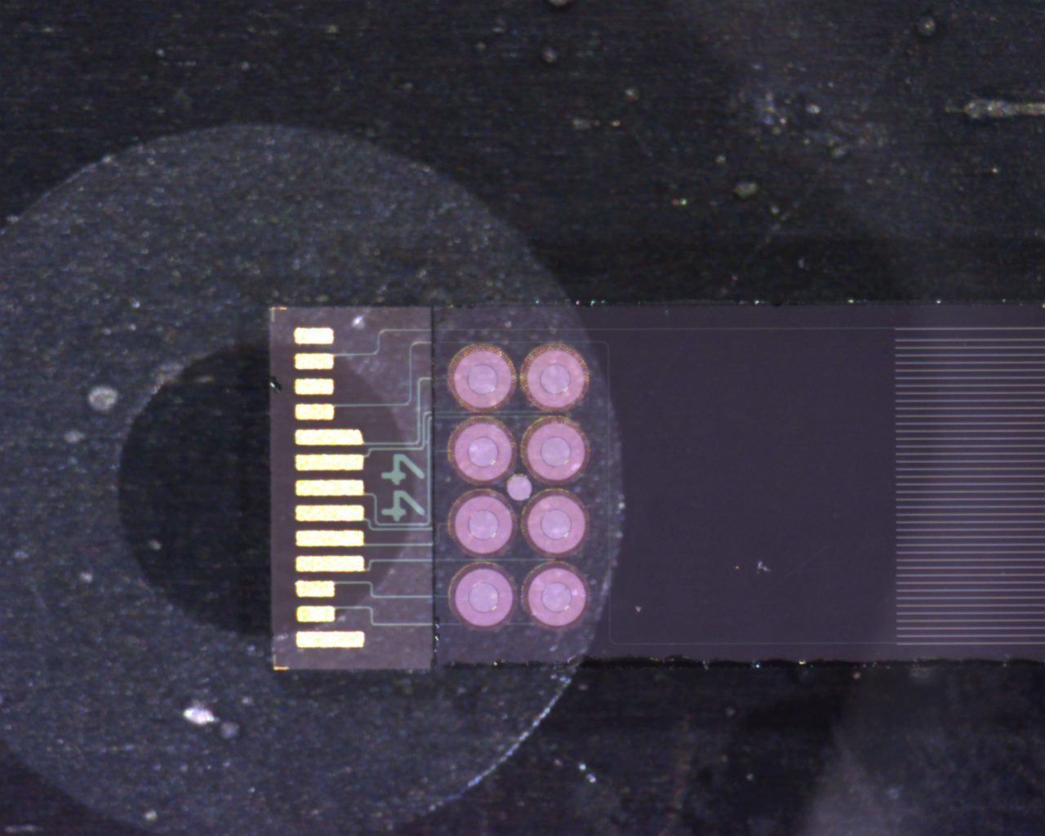
Alignment and Bonding
44 On bottom, this is the first bond.
Orange Area is where copper pad presses down

Slide 3
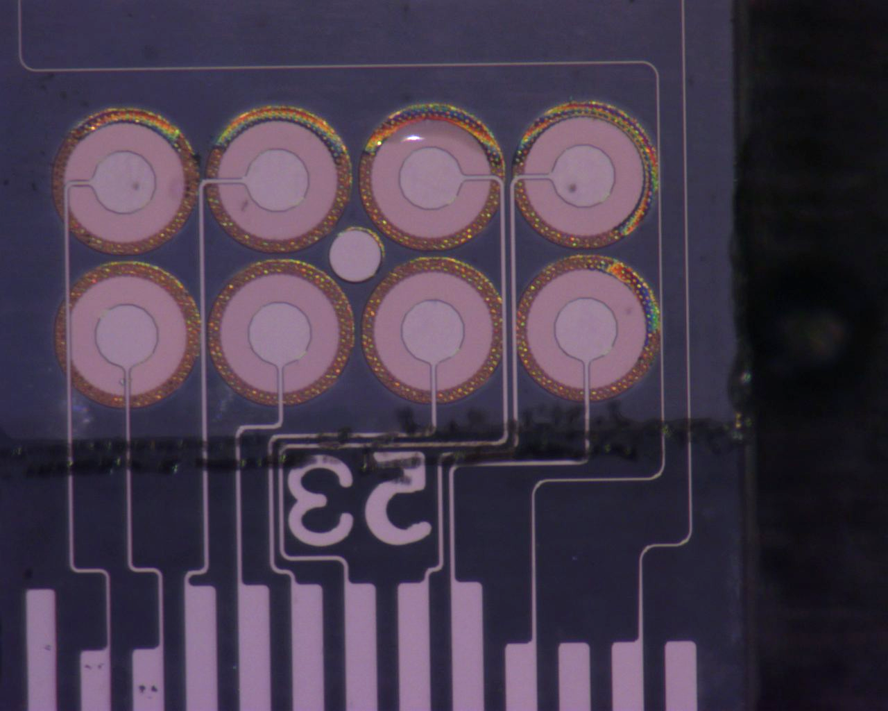
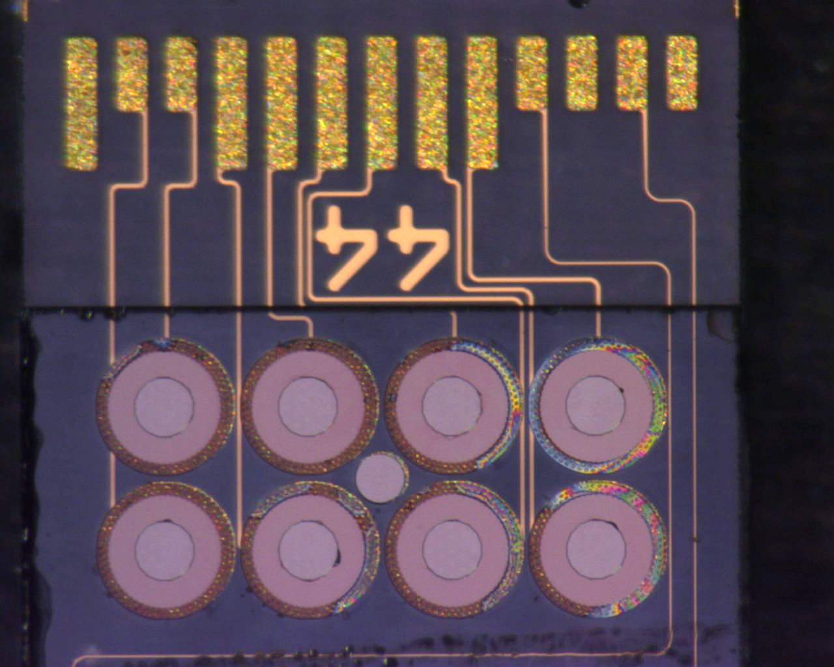
53 Backside
Post Bonding

Slide 4
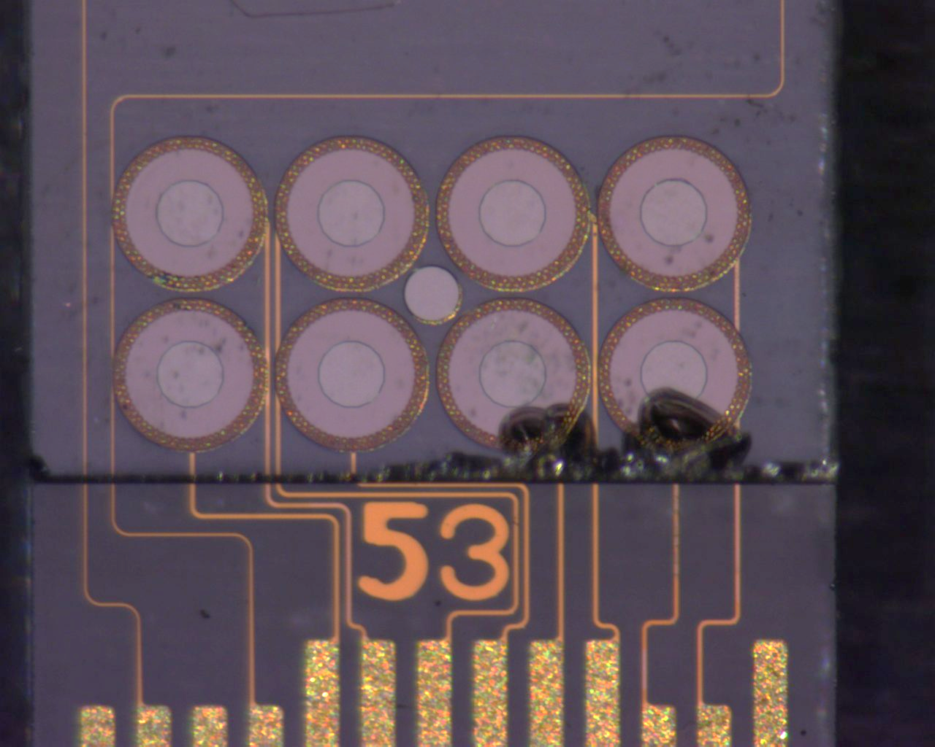
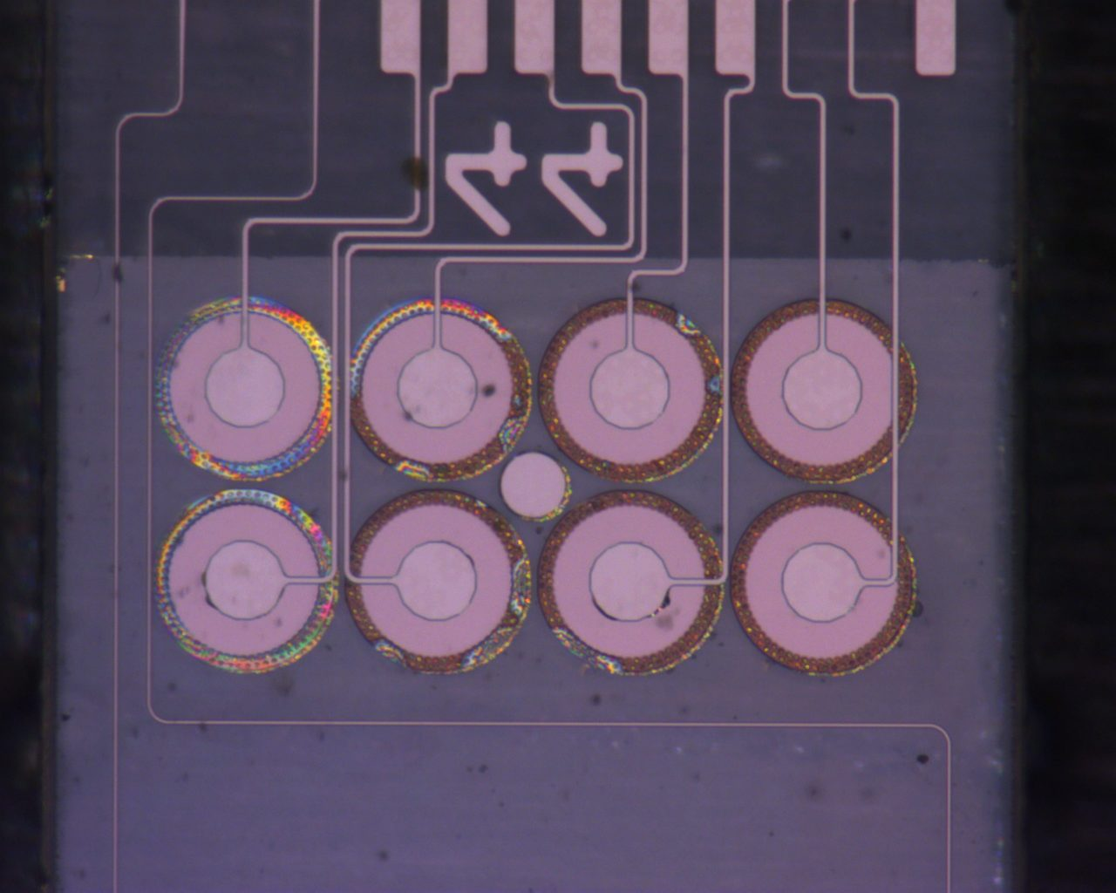
44 Backside
Post Bonding

Slide 5
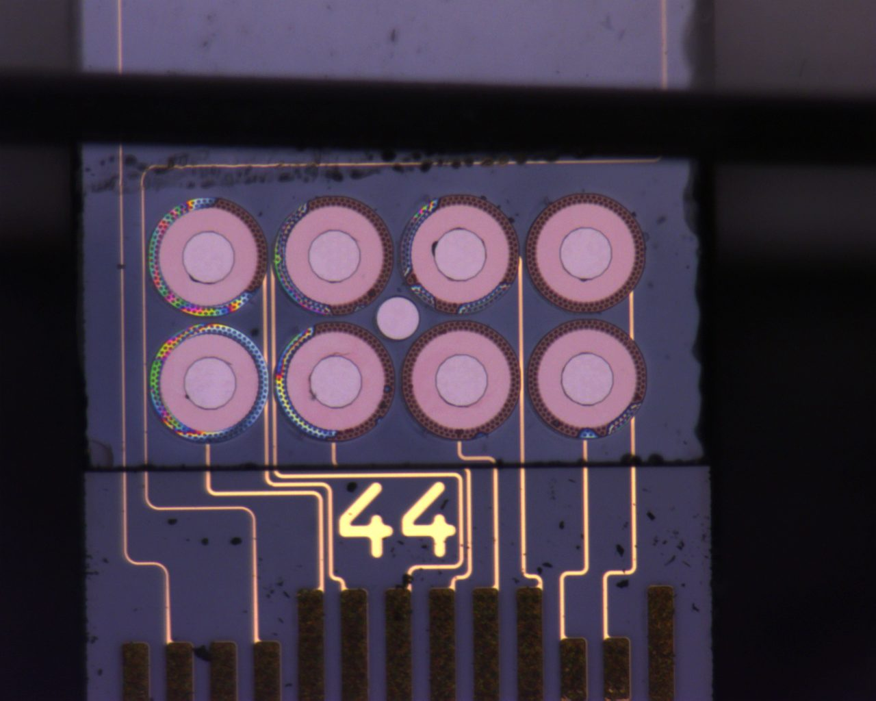
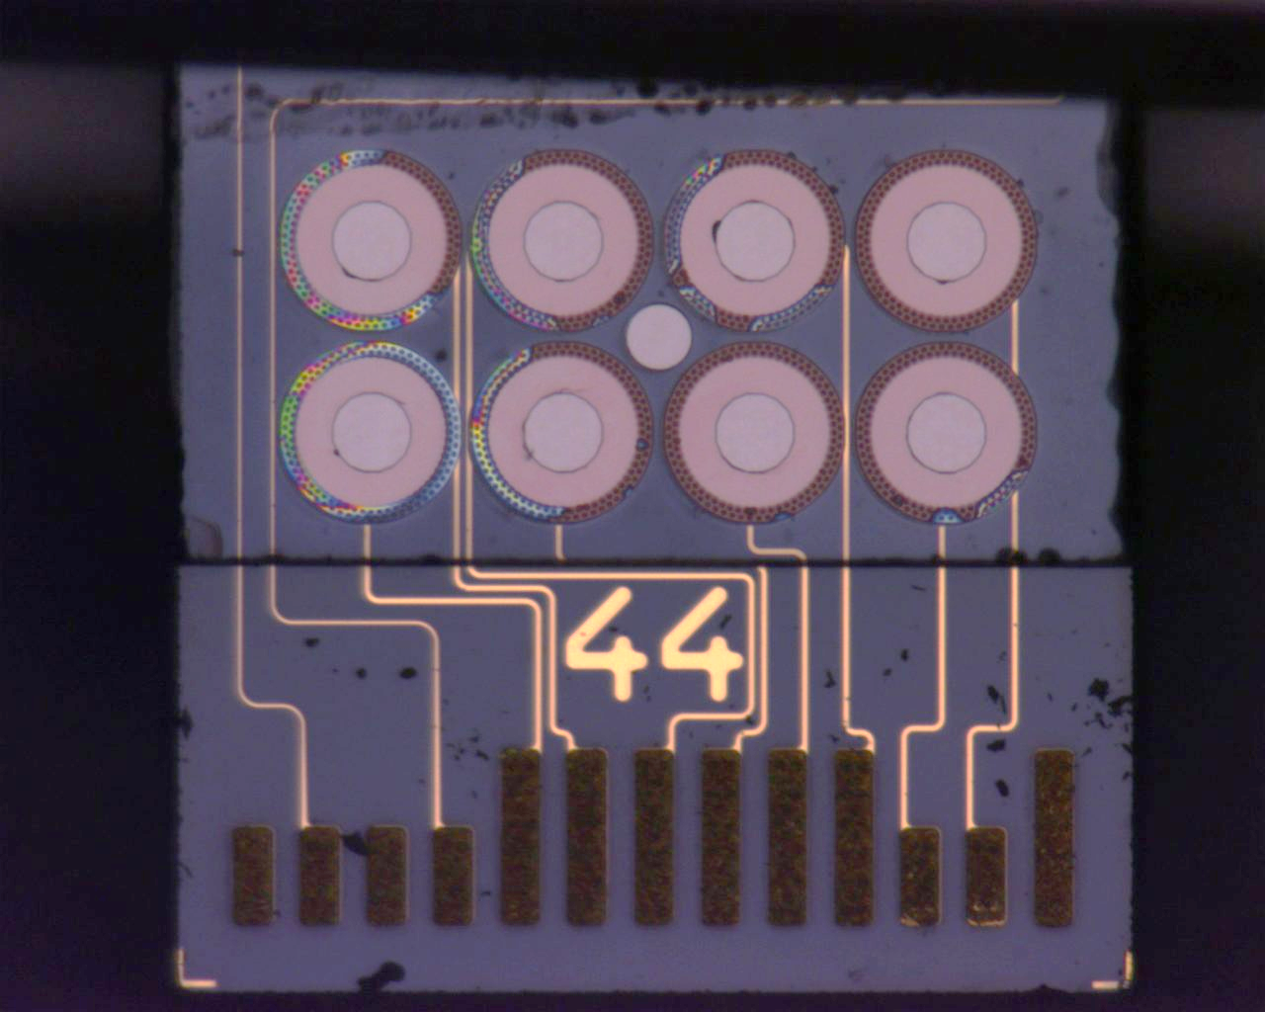
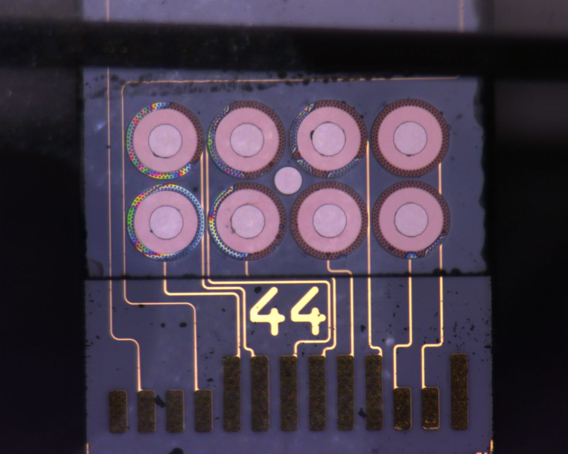
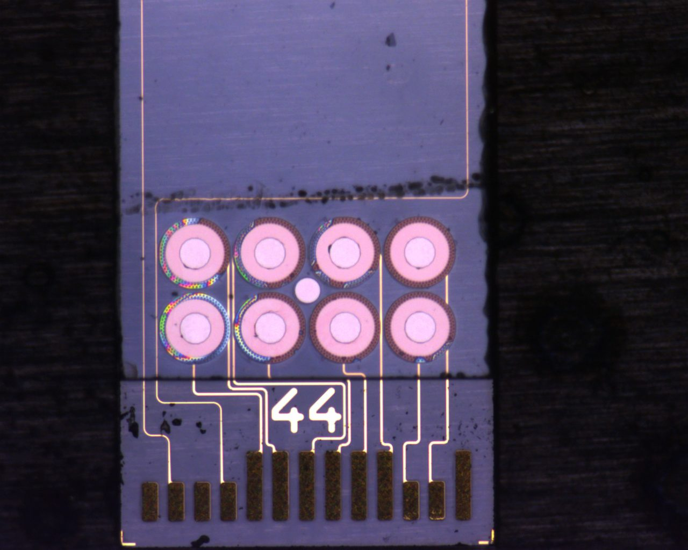
53 Backside
Pull Test Pre Anneal Progression 1-4N

Slide 6
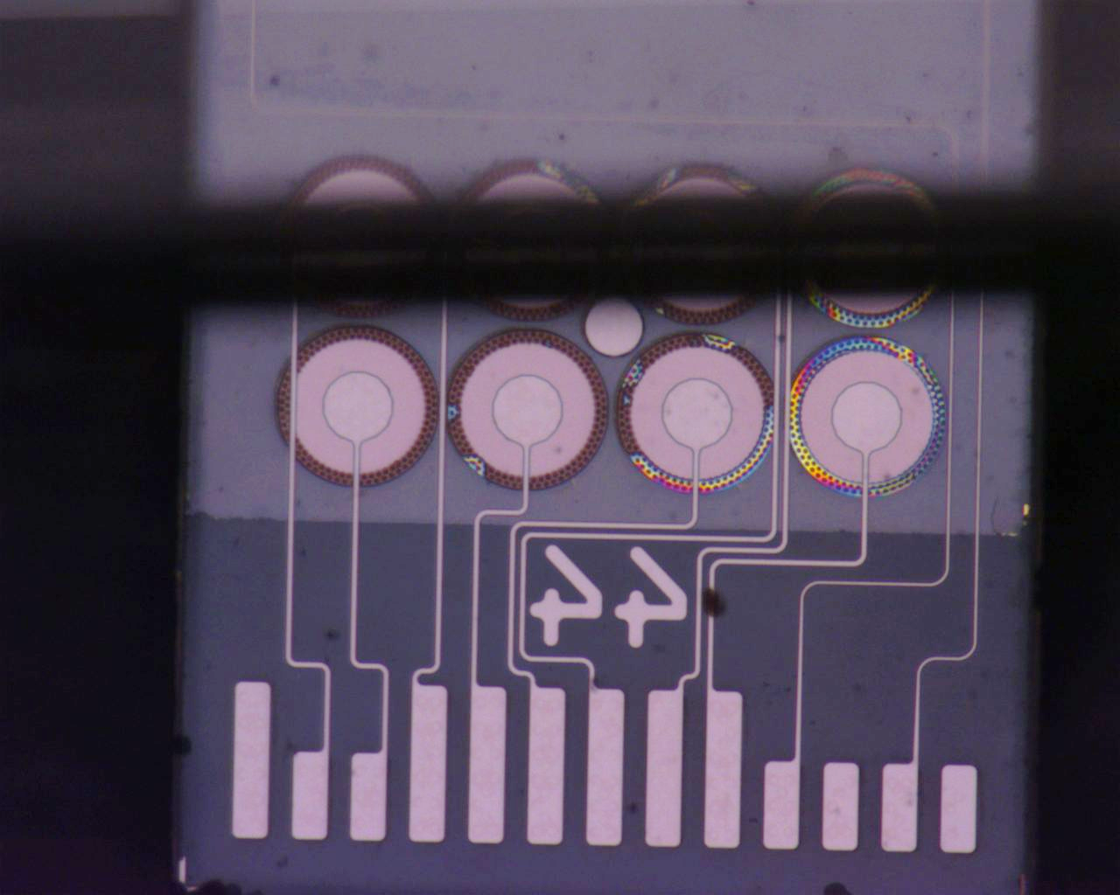
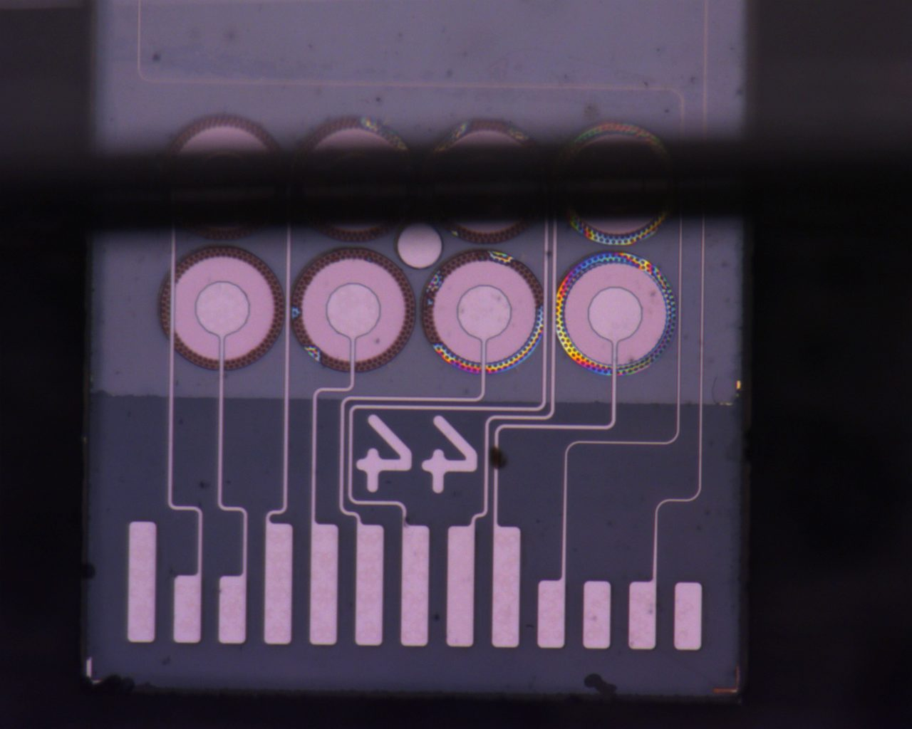
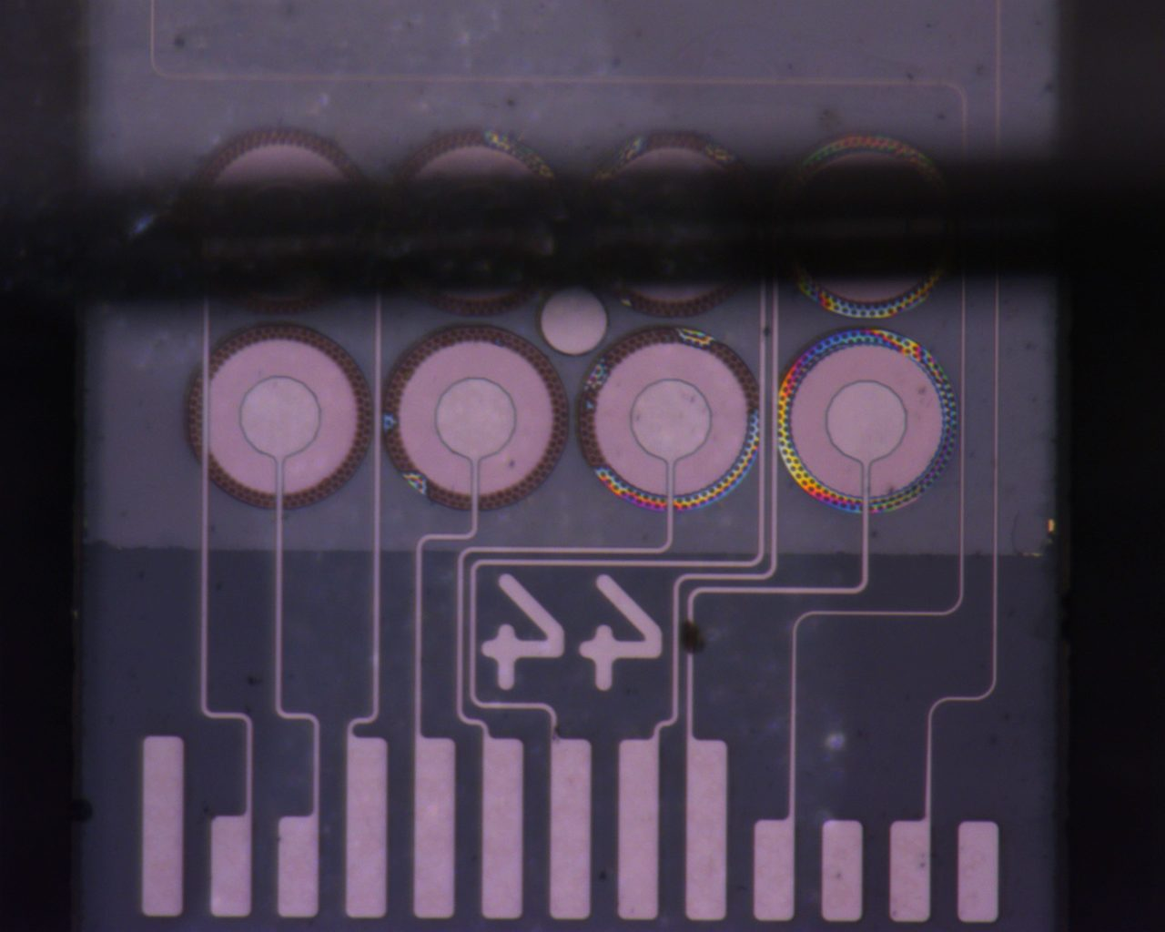
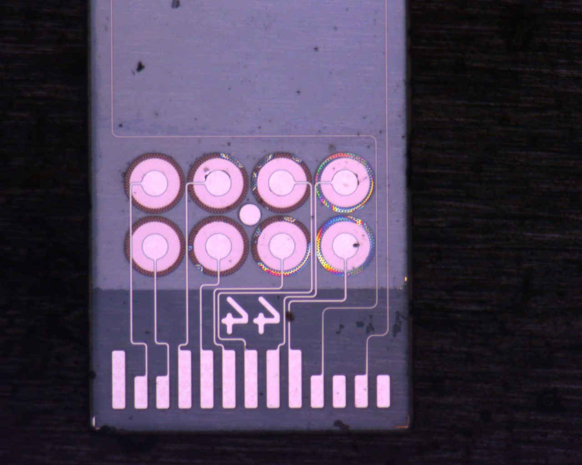
44 Backside
Pull Test Progression 1-4N

Slide 7
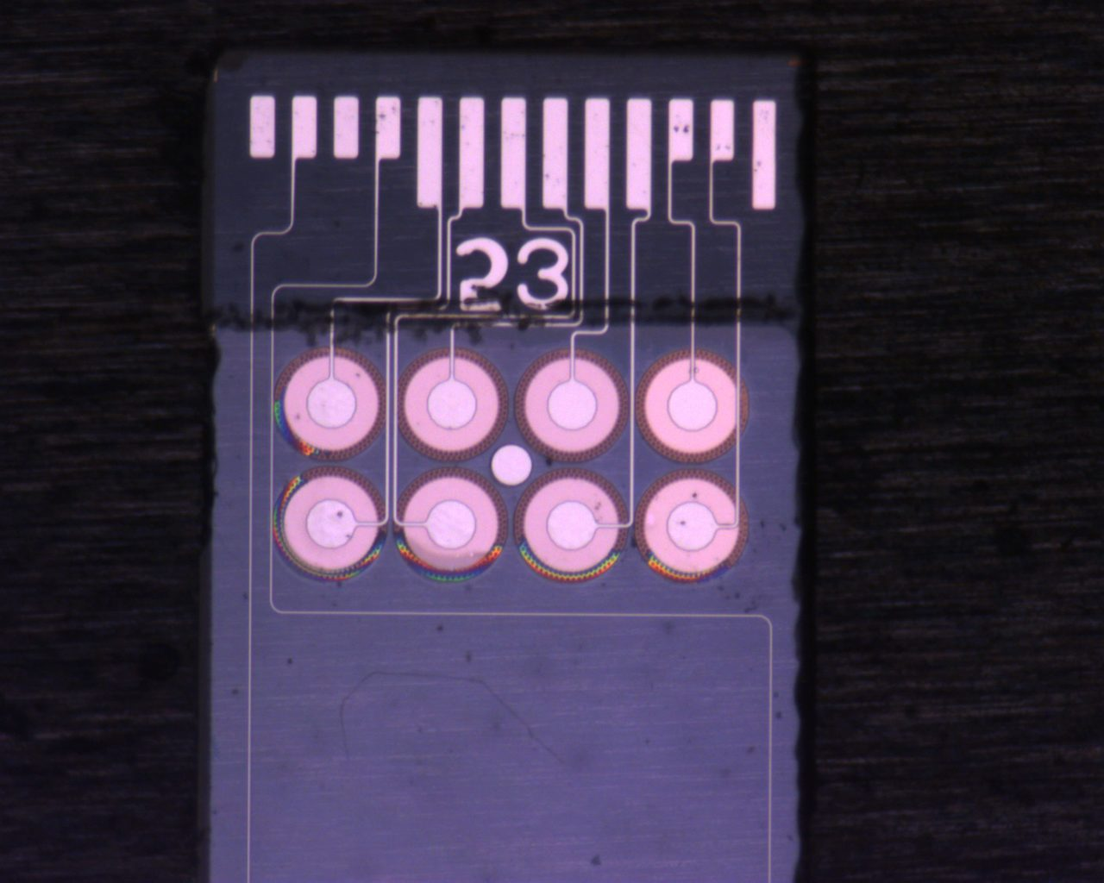
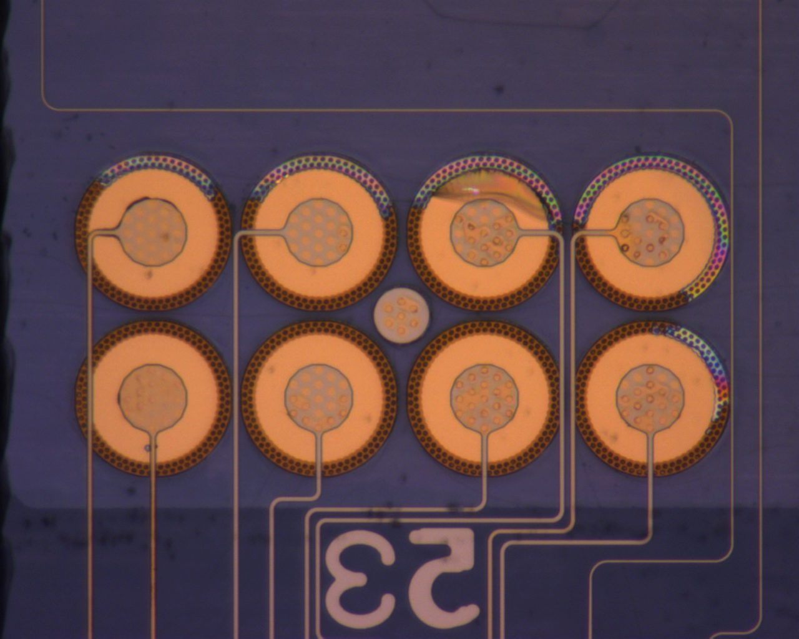
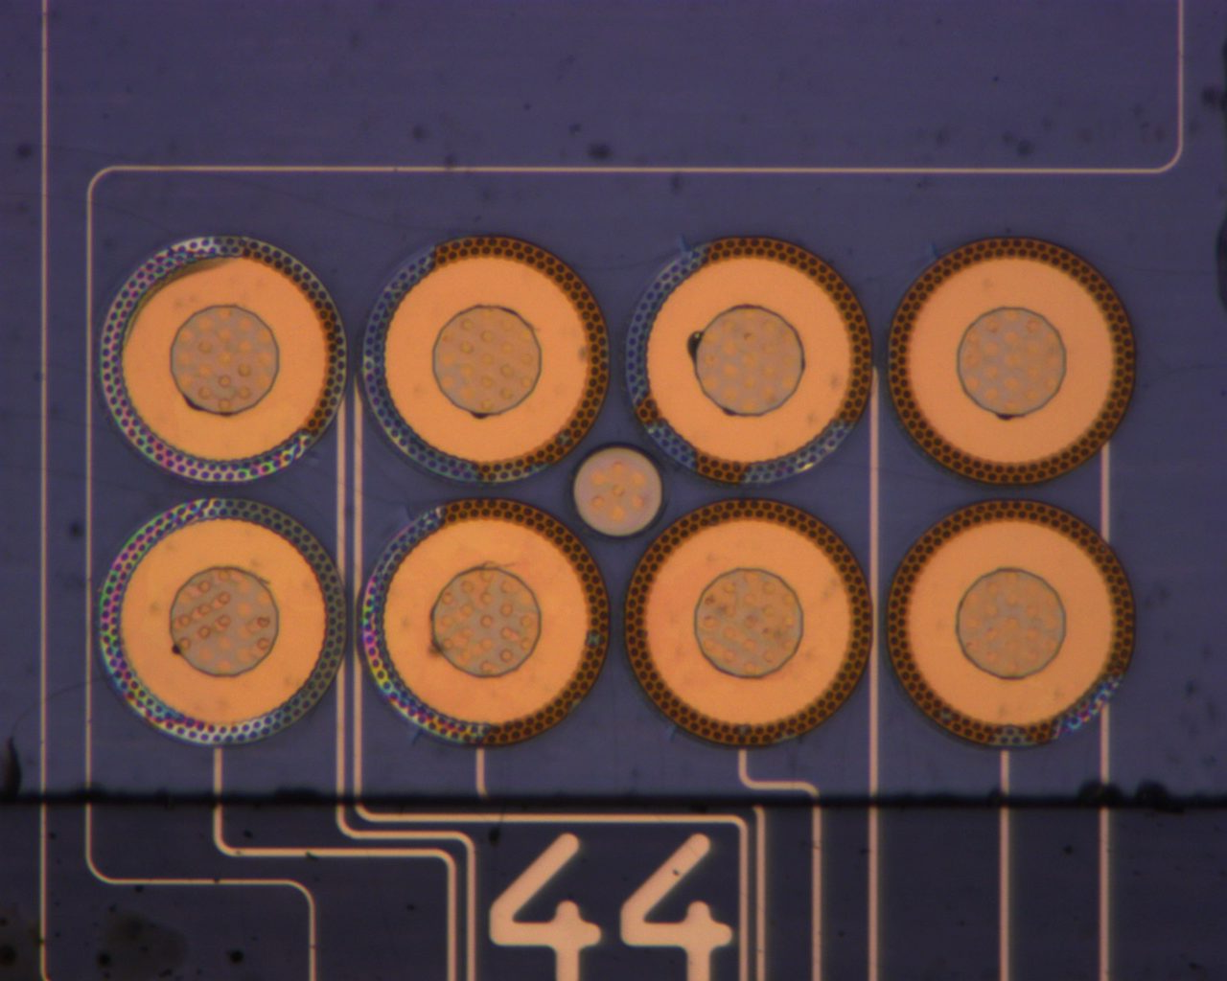
53 Backside
Post Anneal

Slide 8
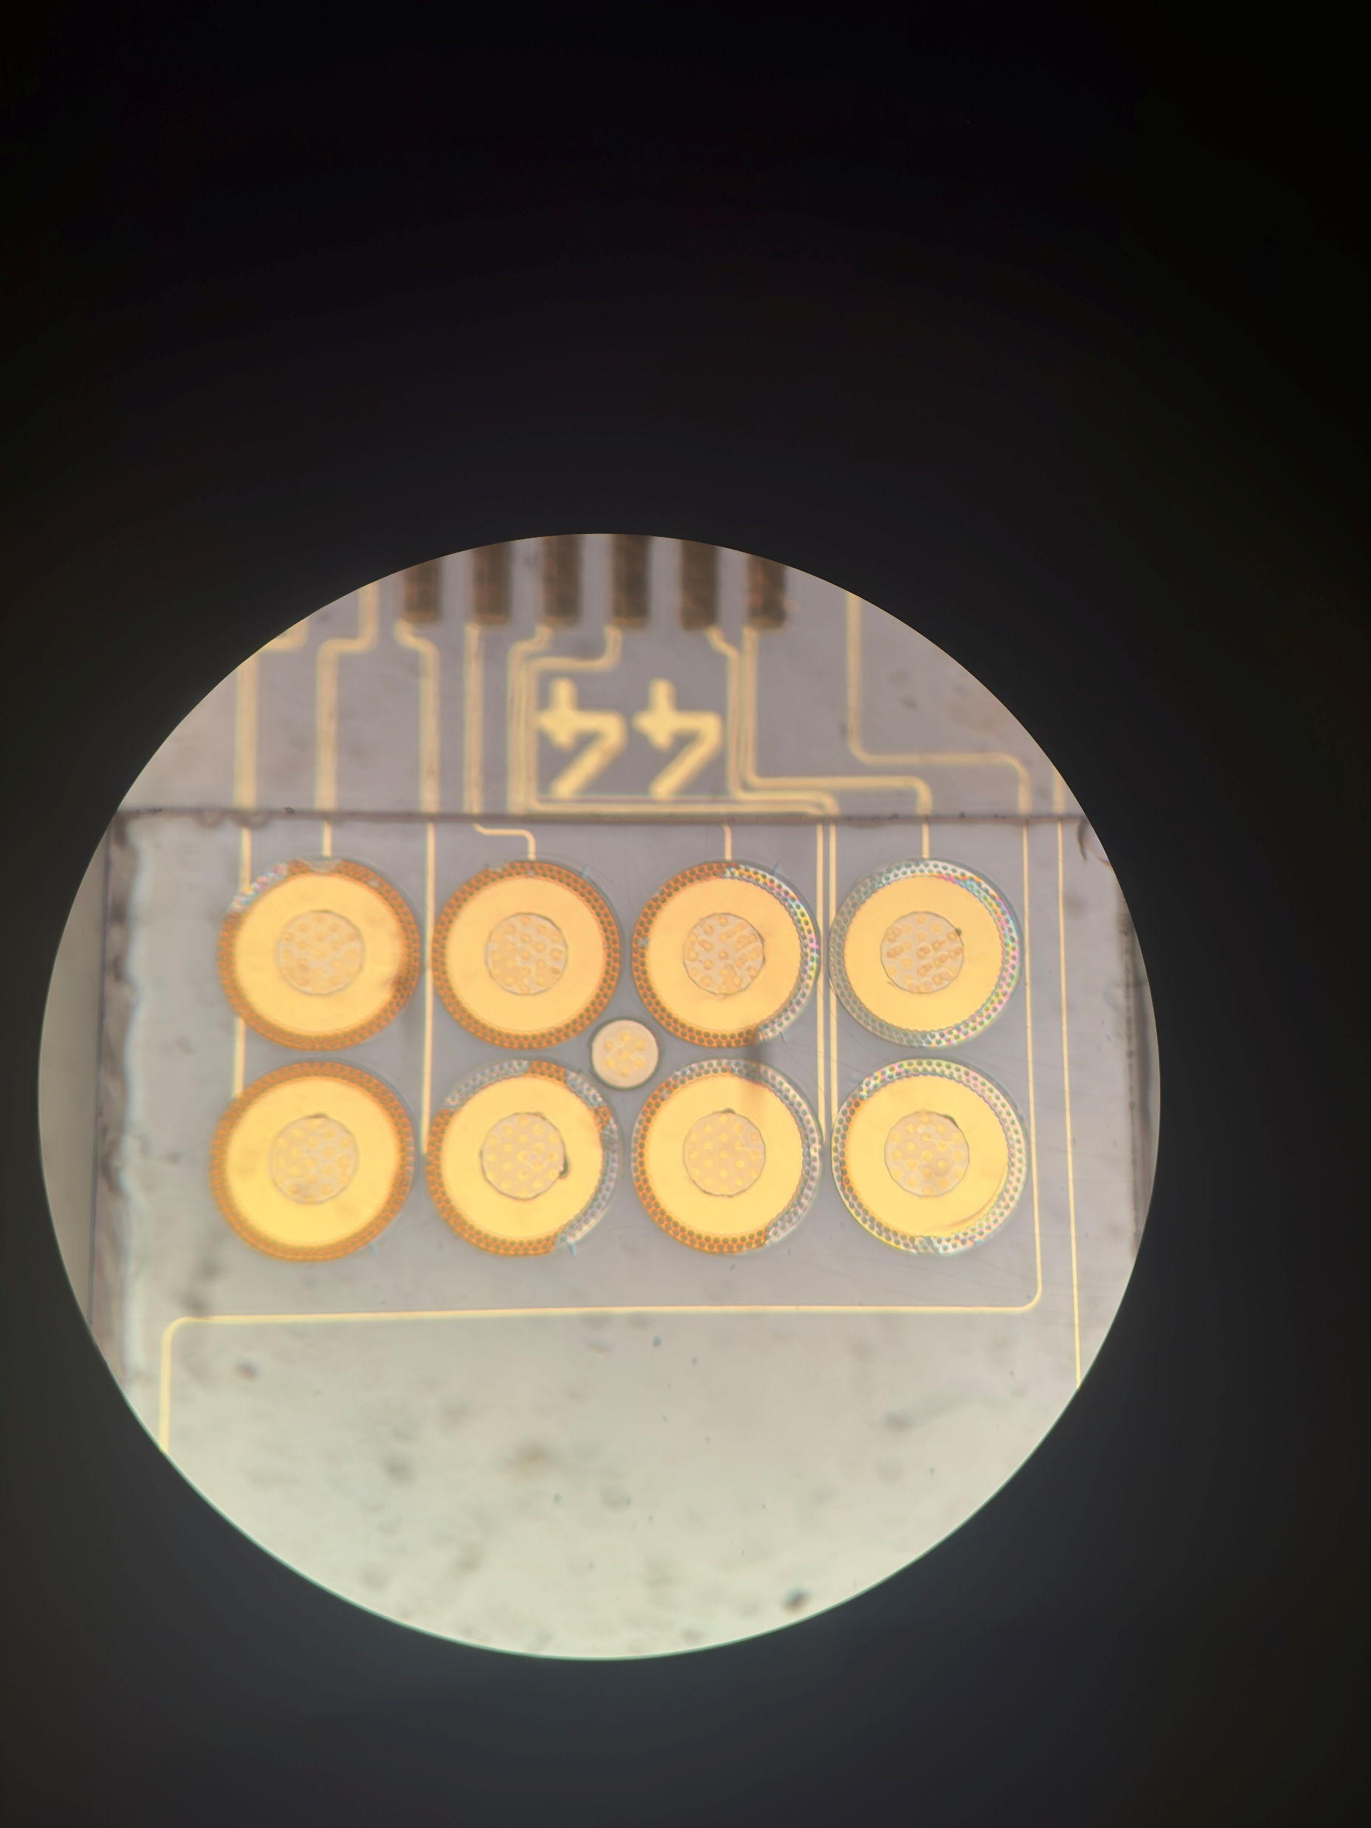
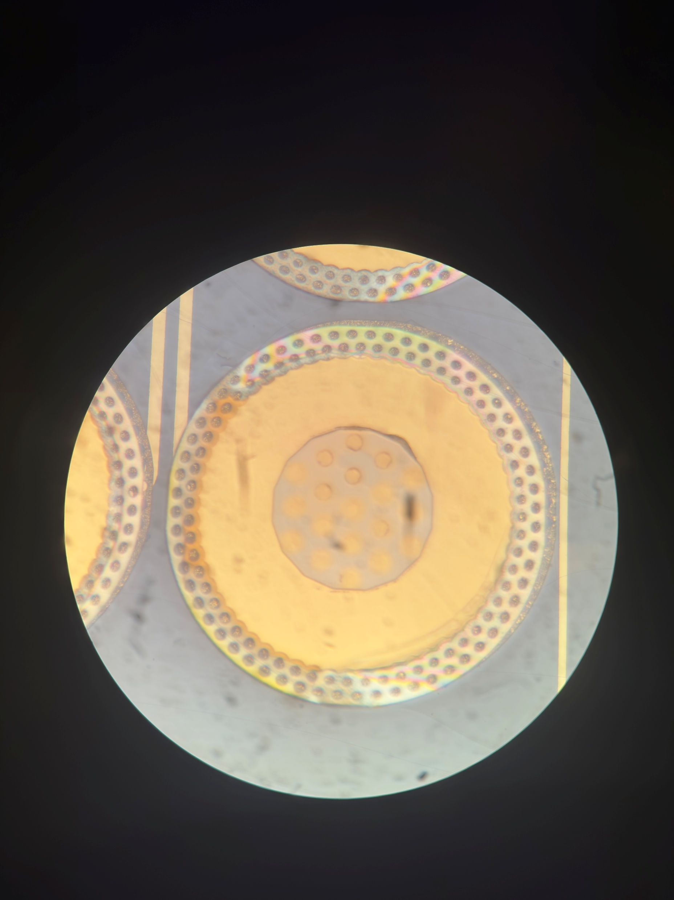
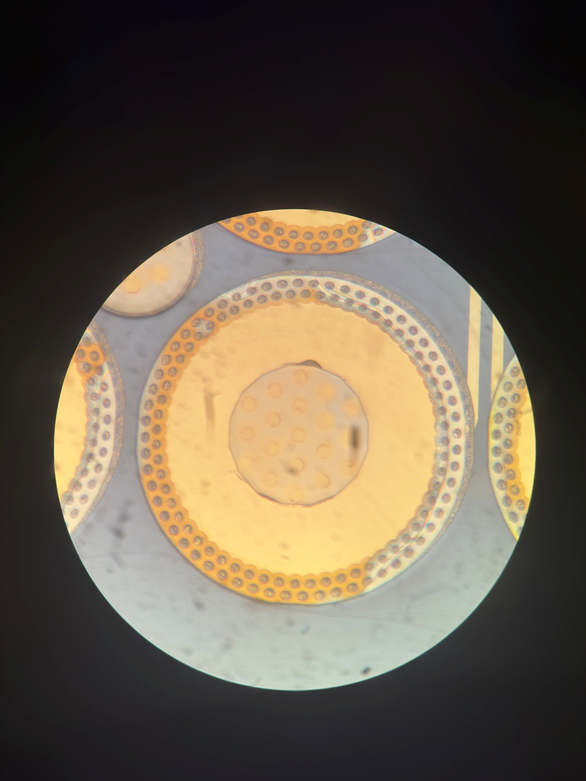
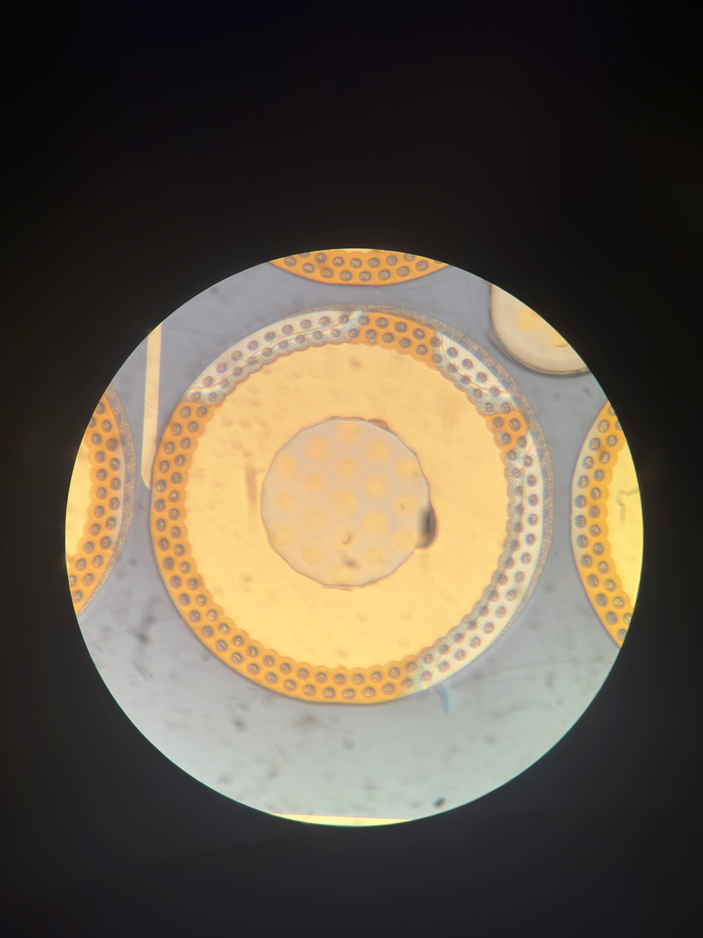
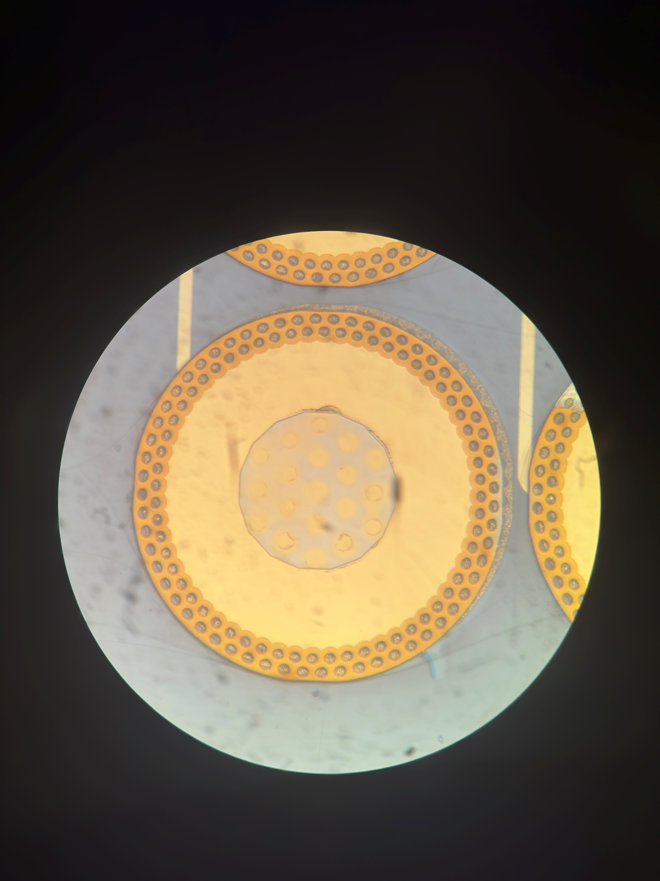
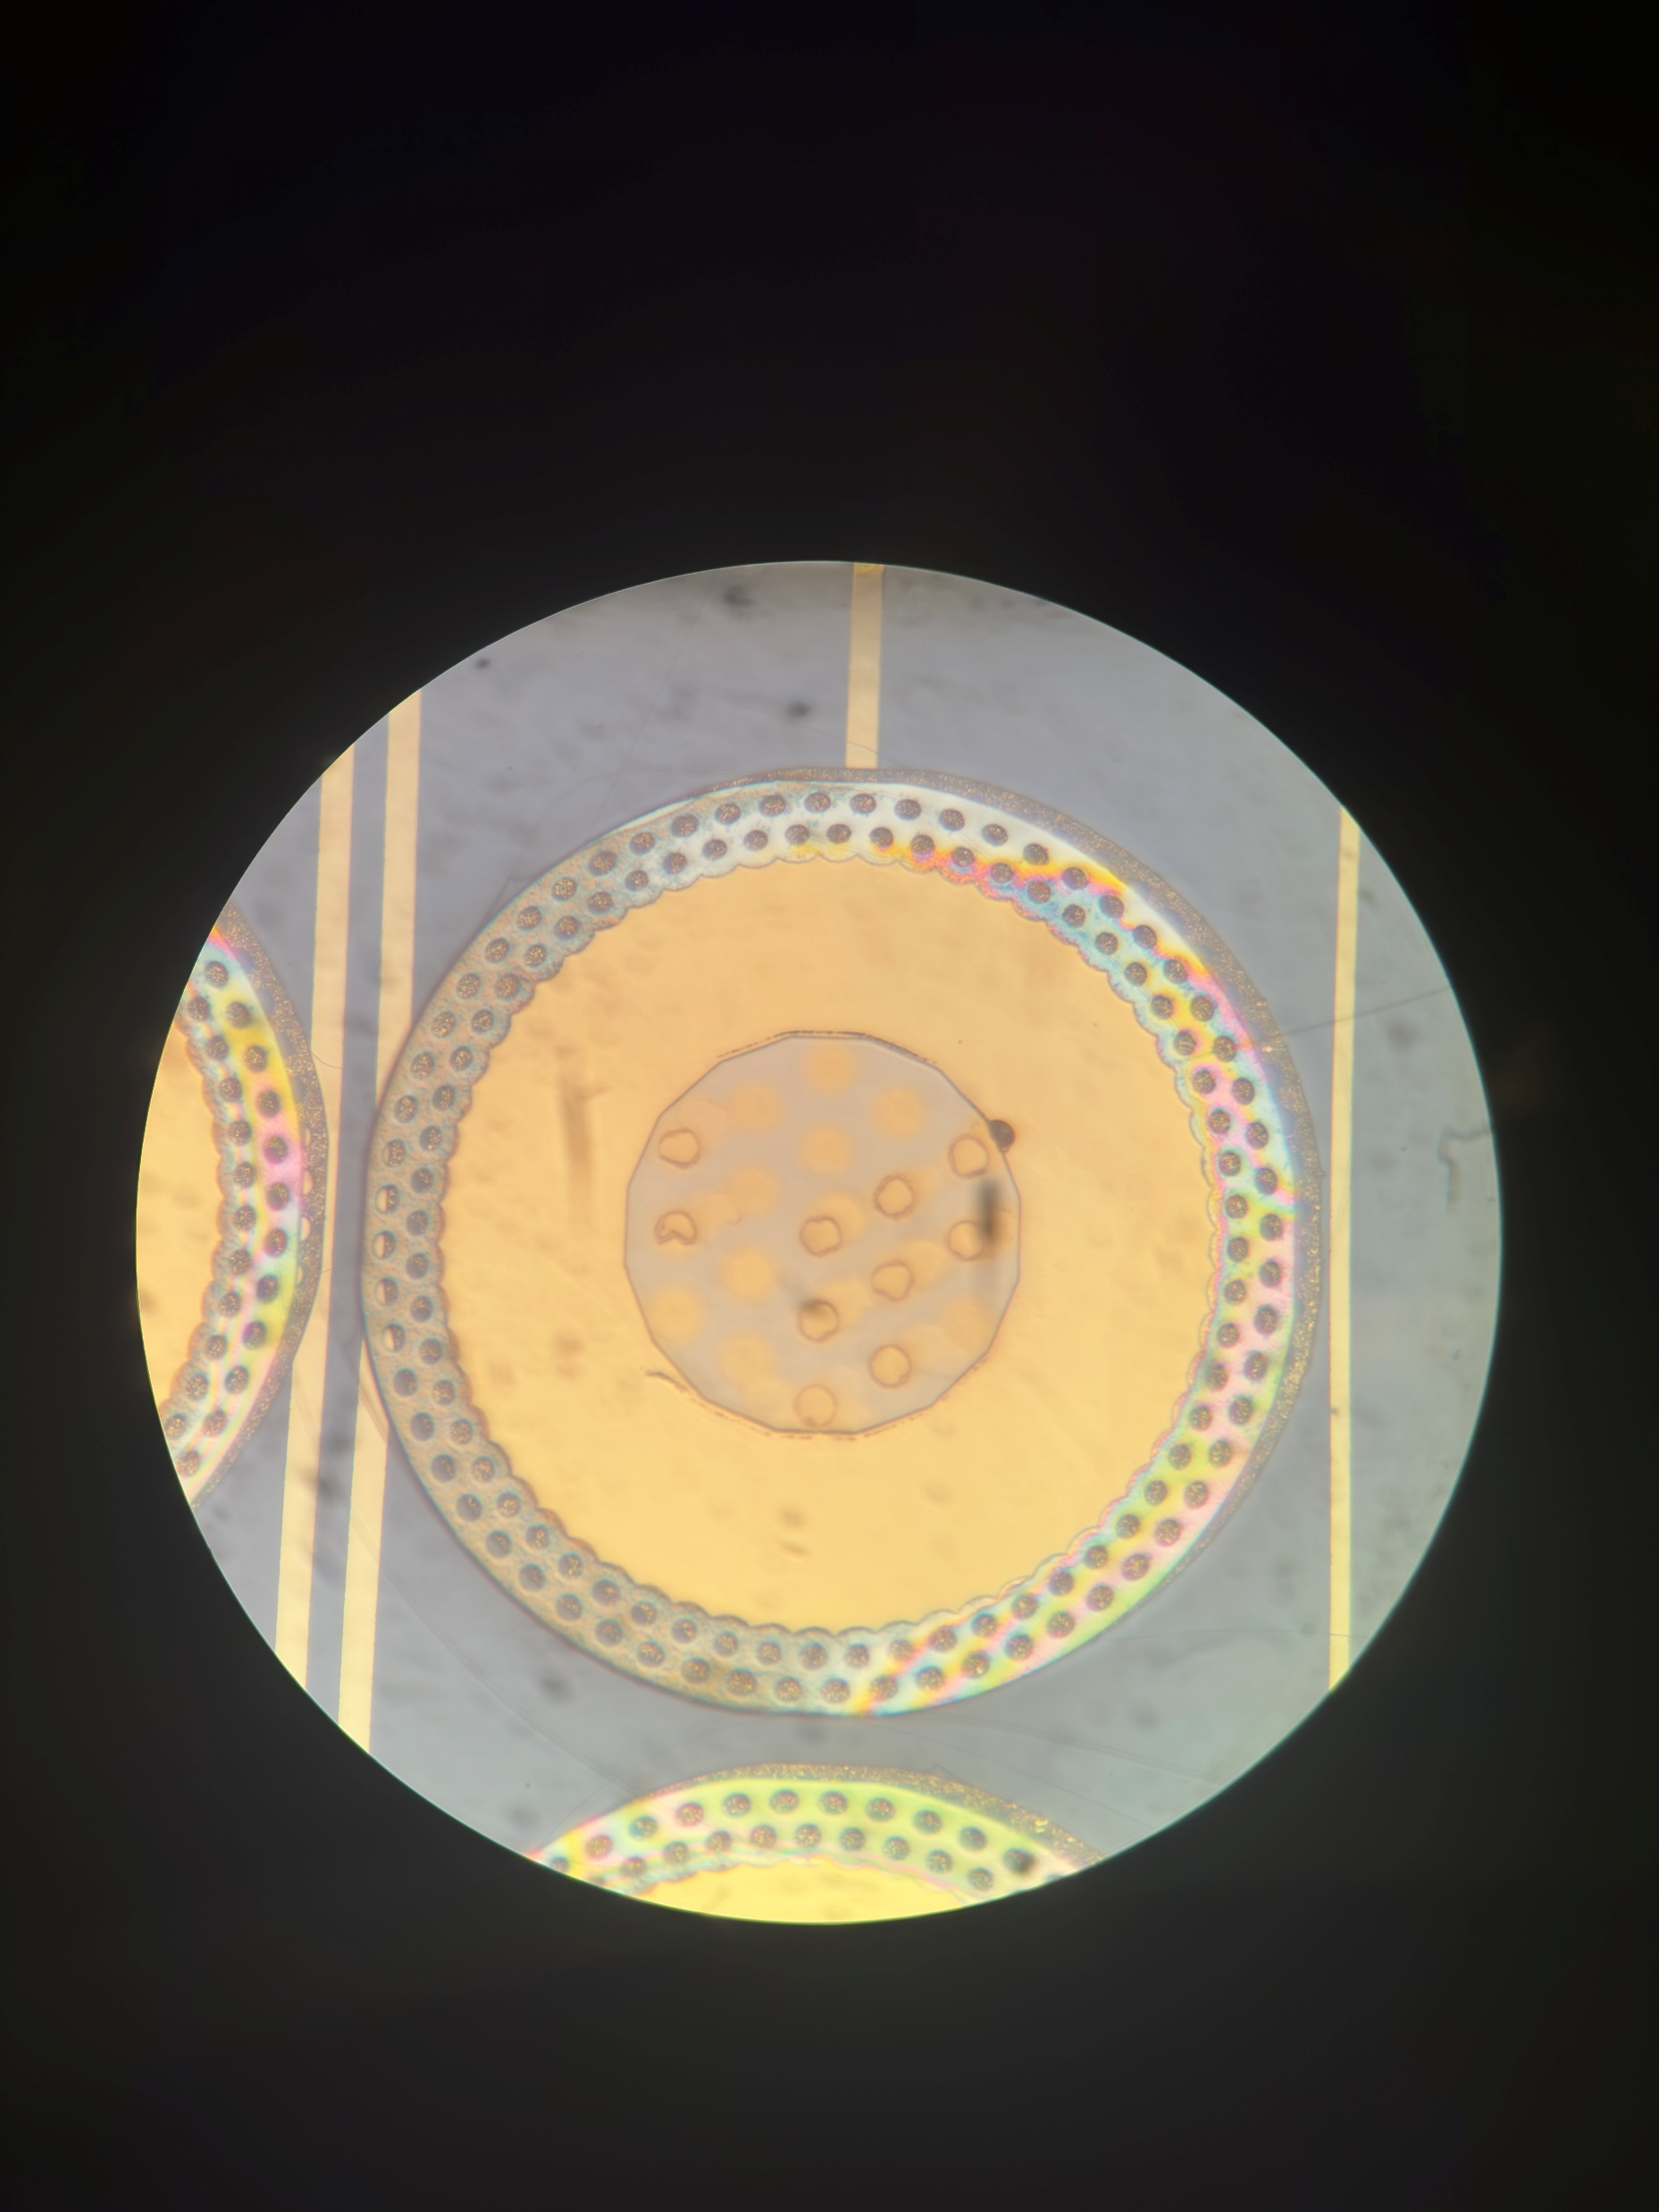
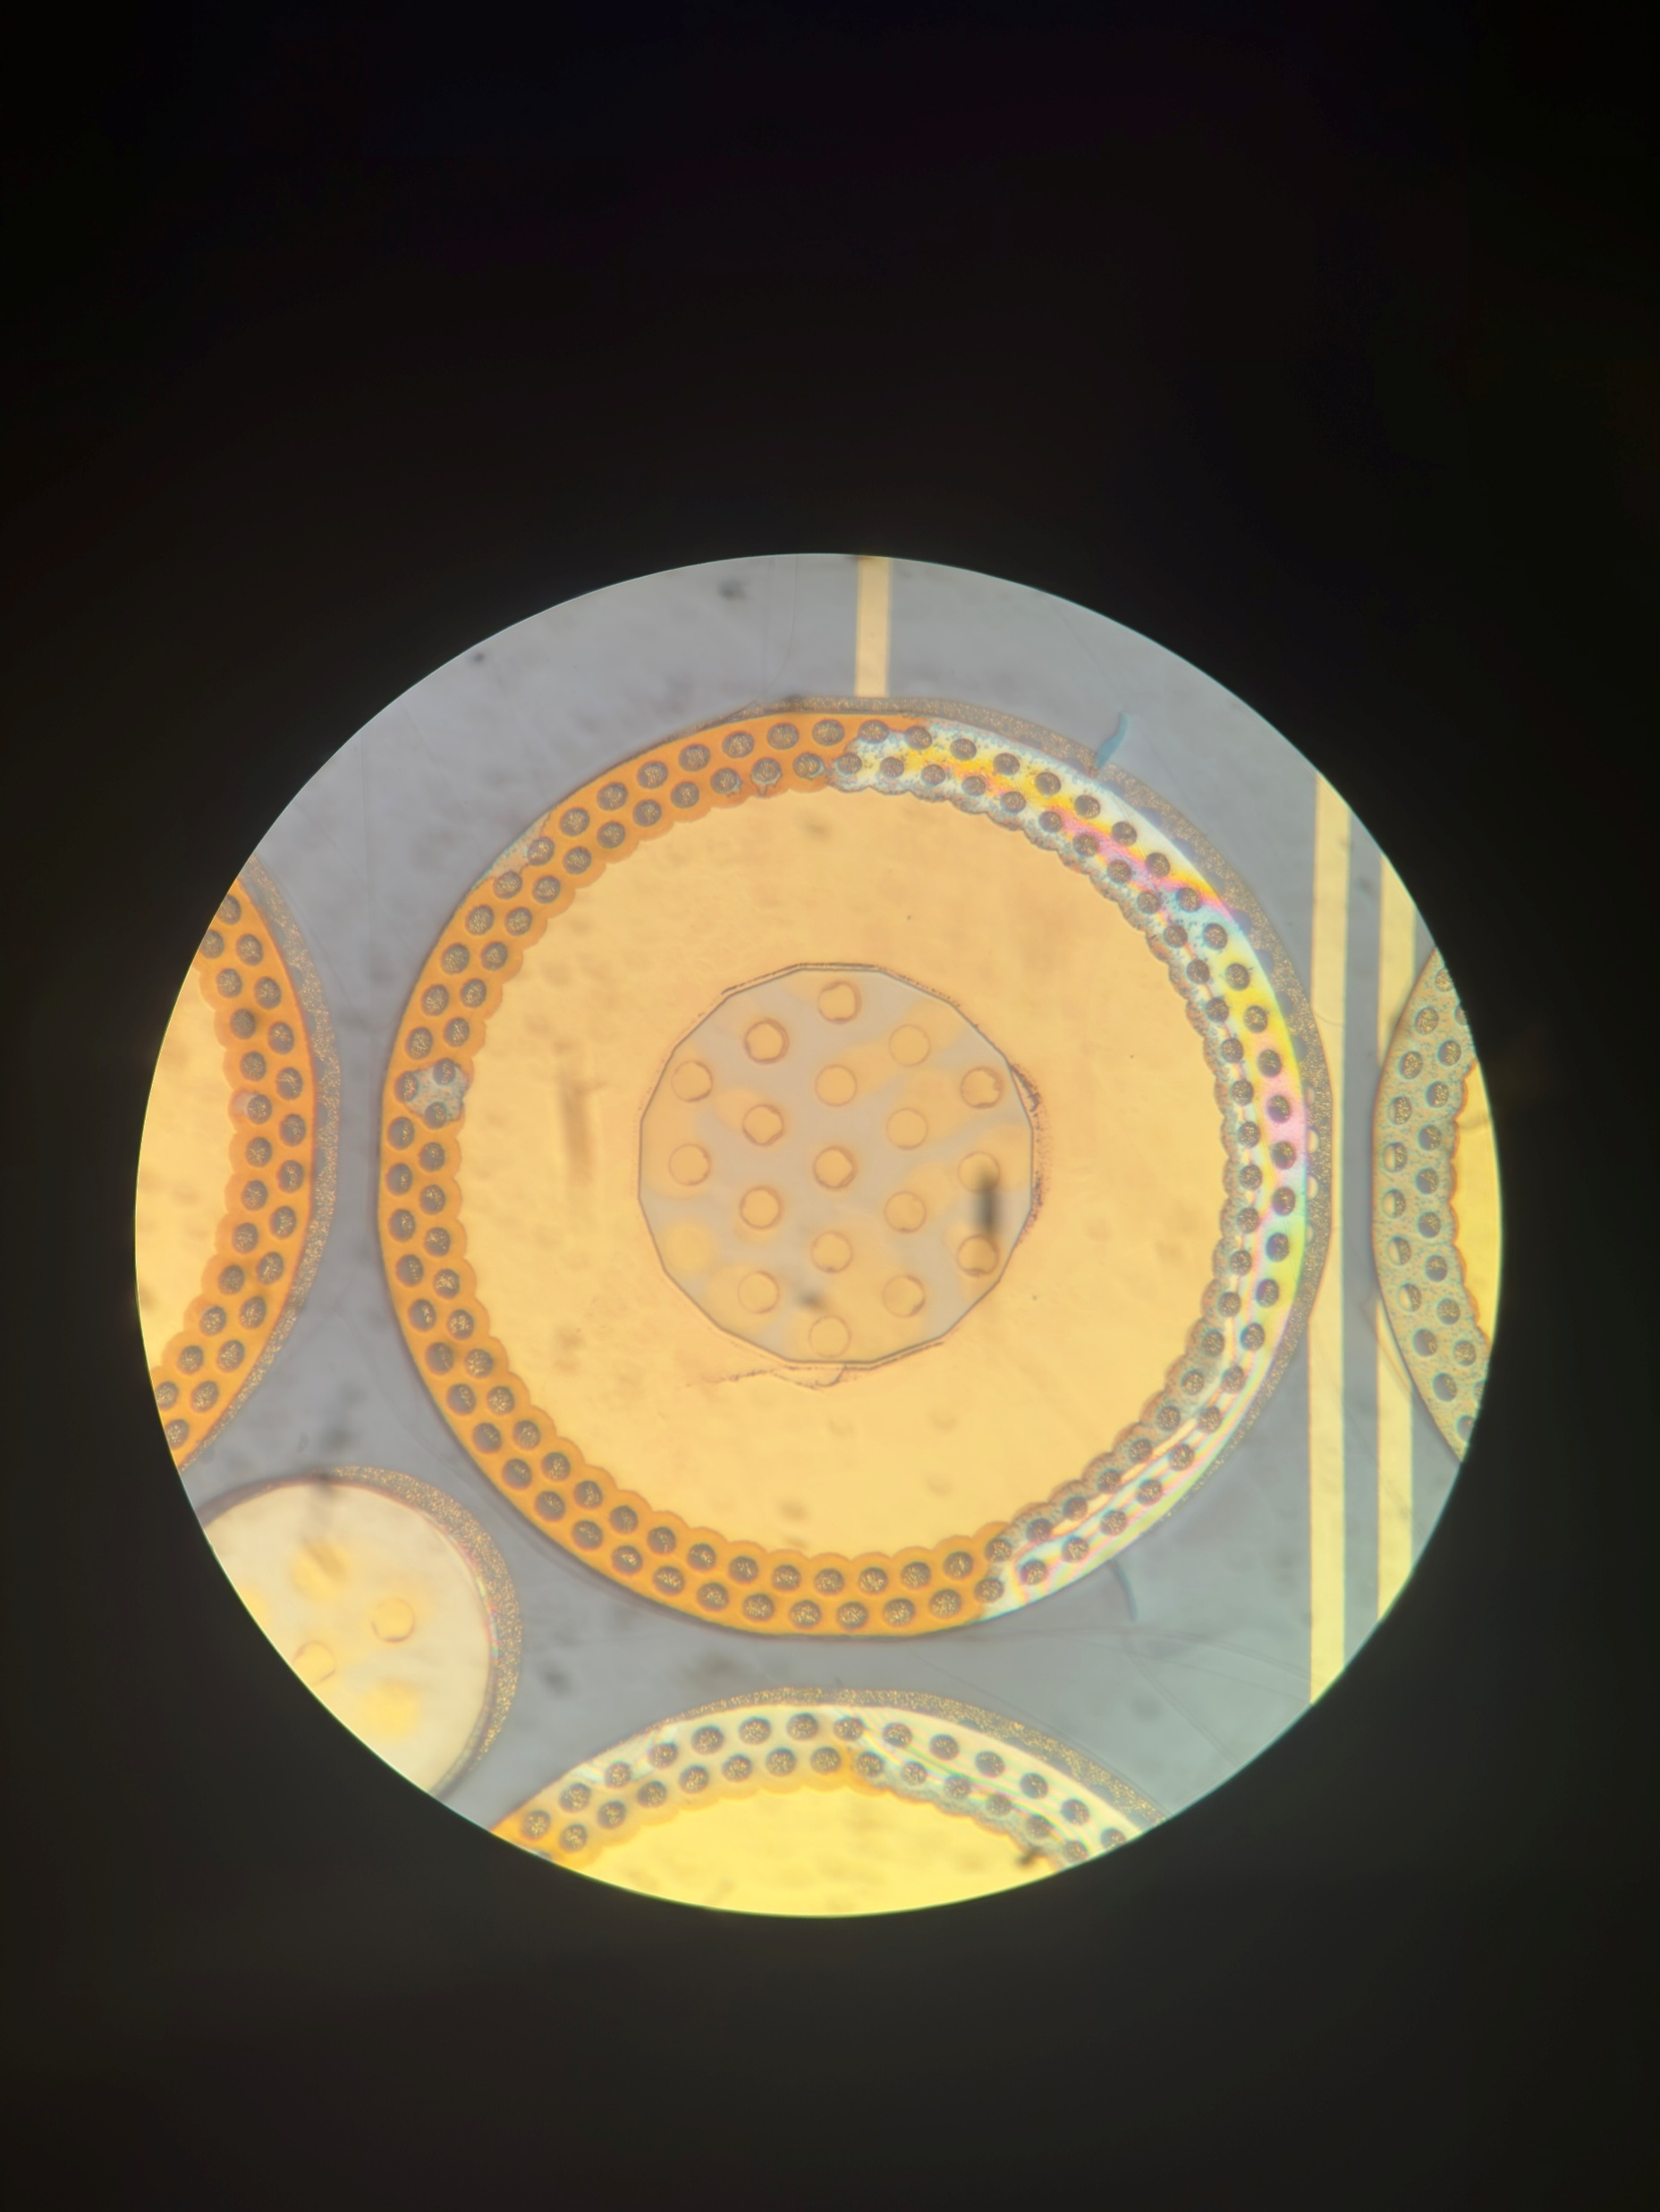
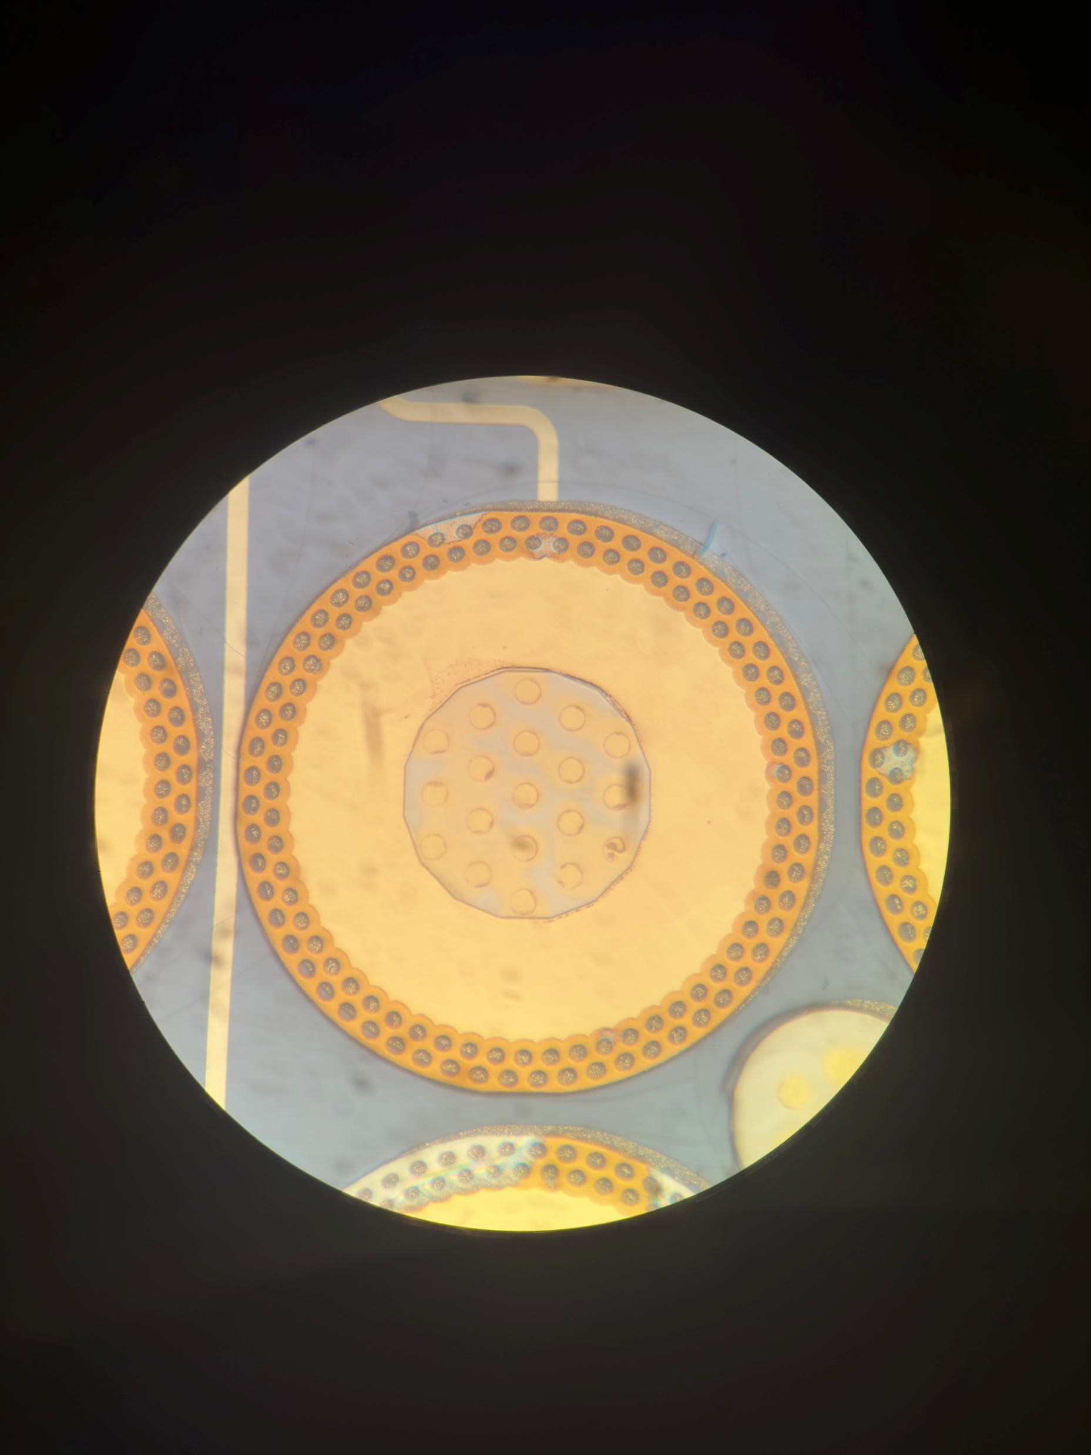
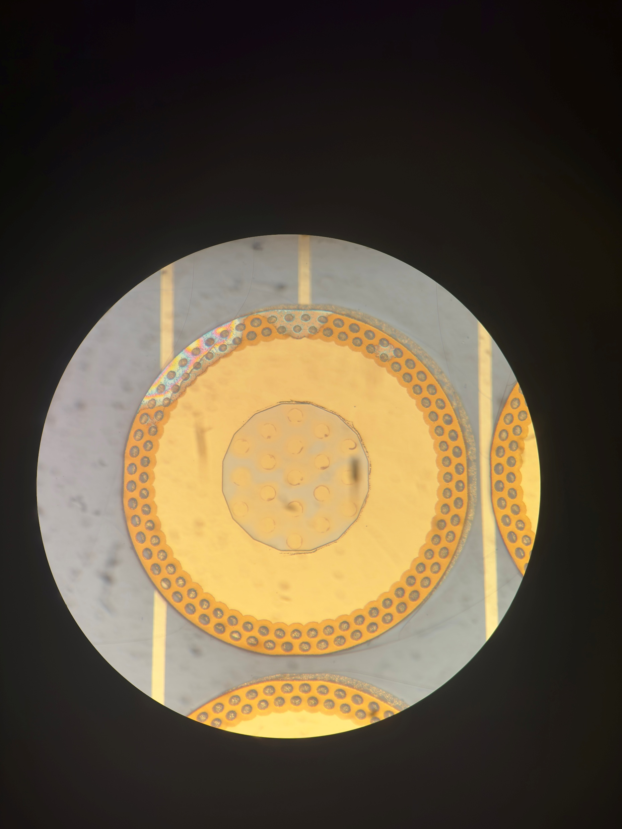
53 Backside Farside
Post Anneal

Slide 9
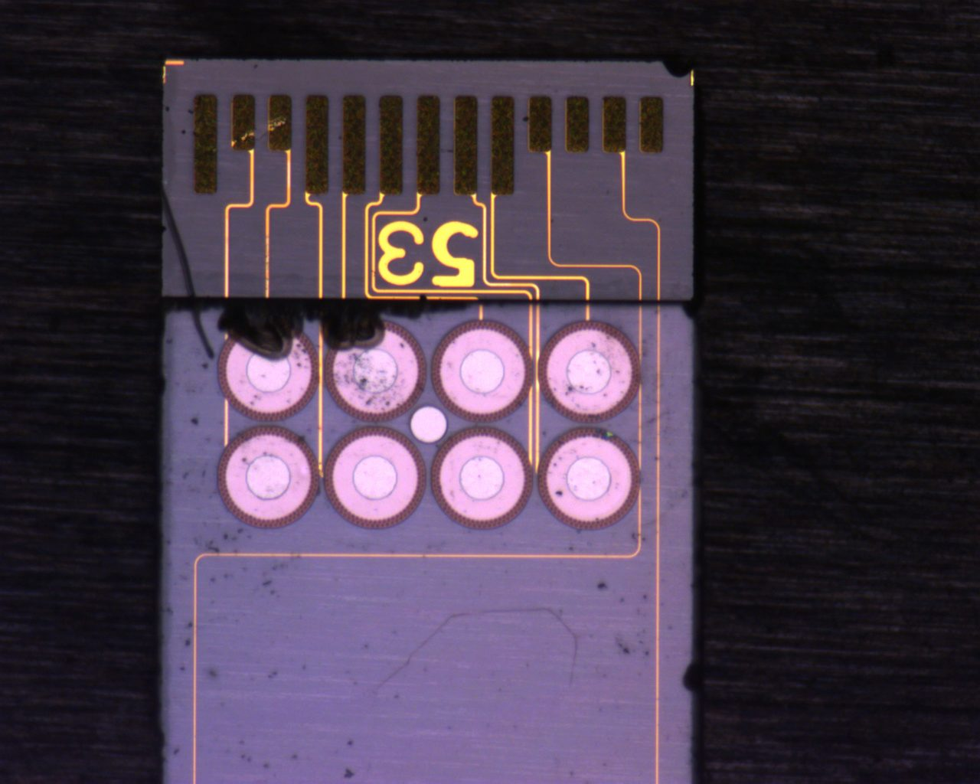
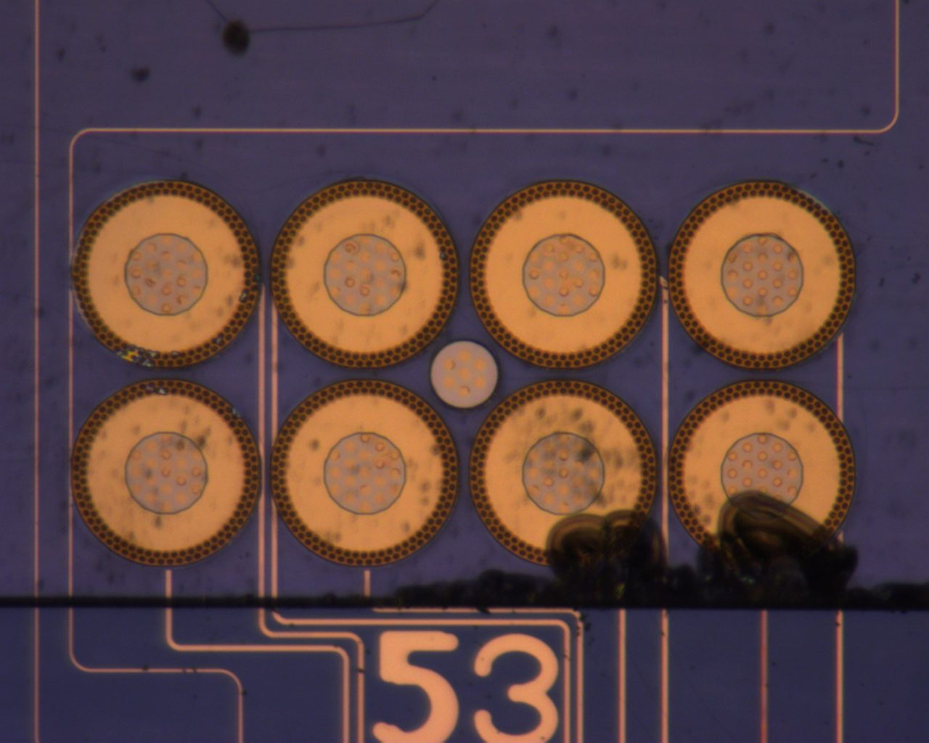
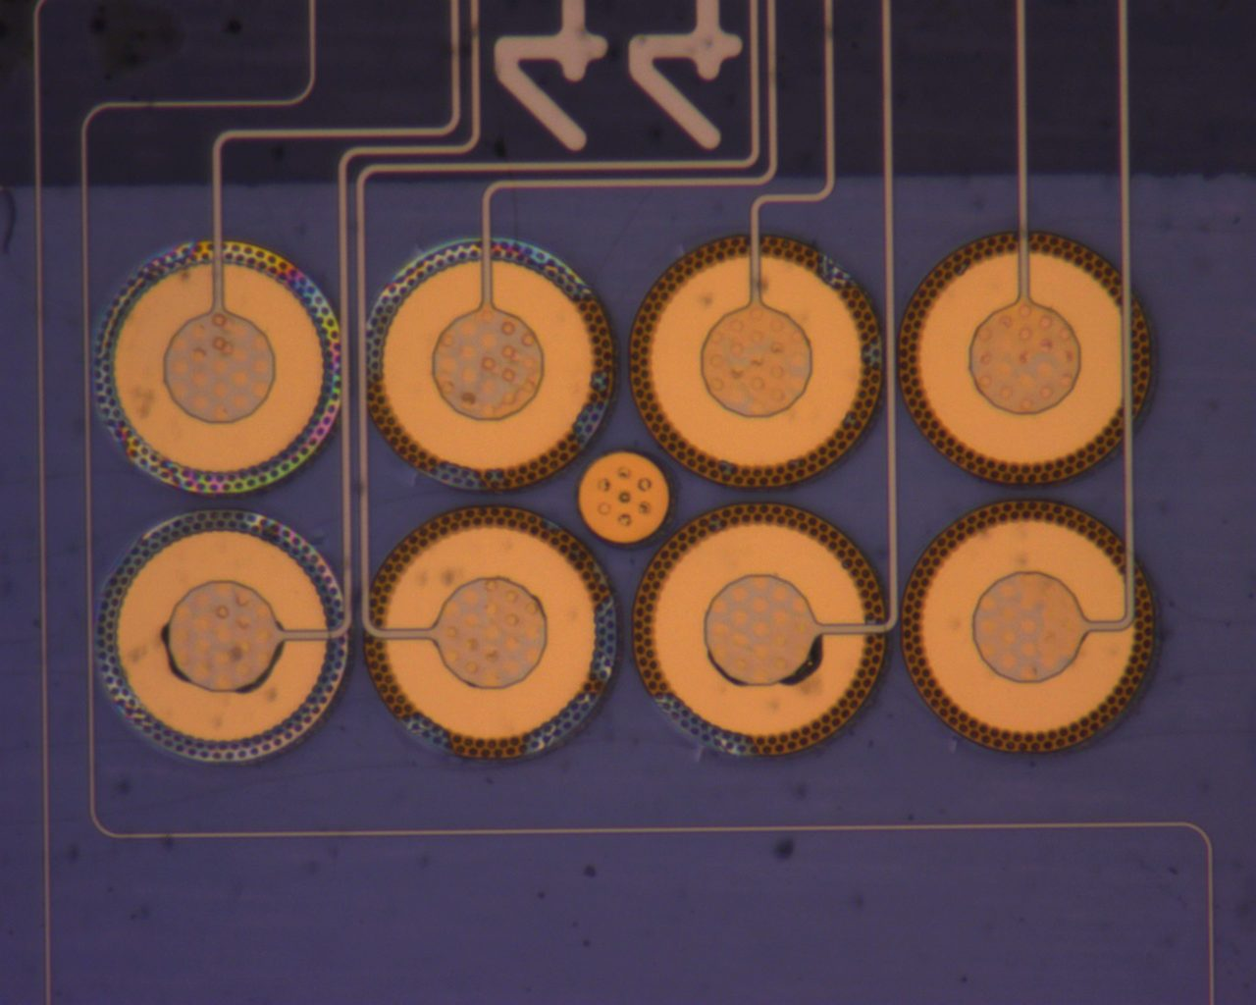
44 Backside
Post Anneal

Slide 10
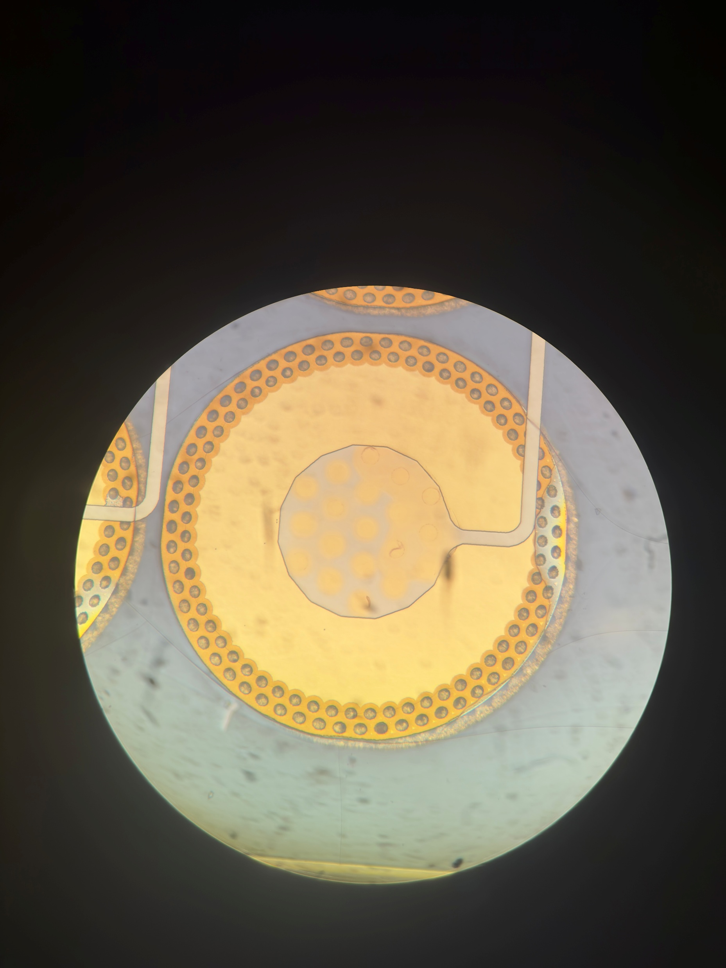
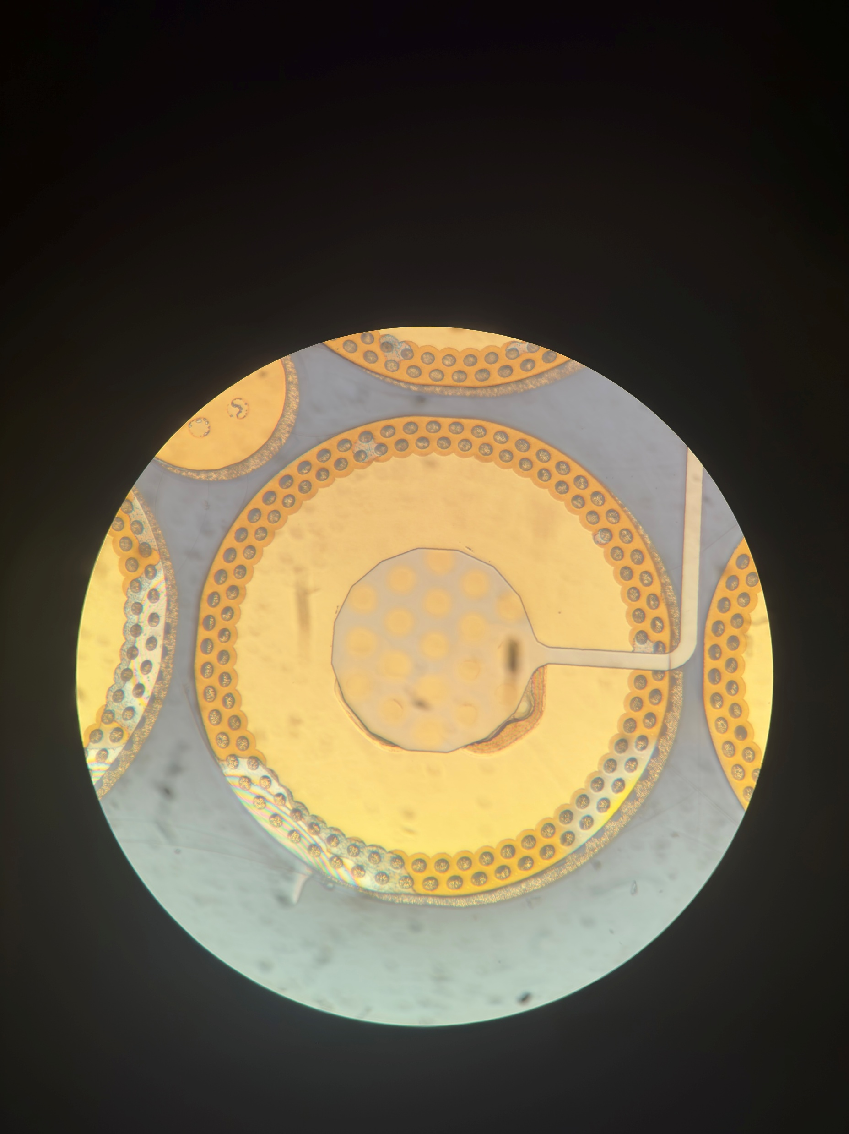
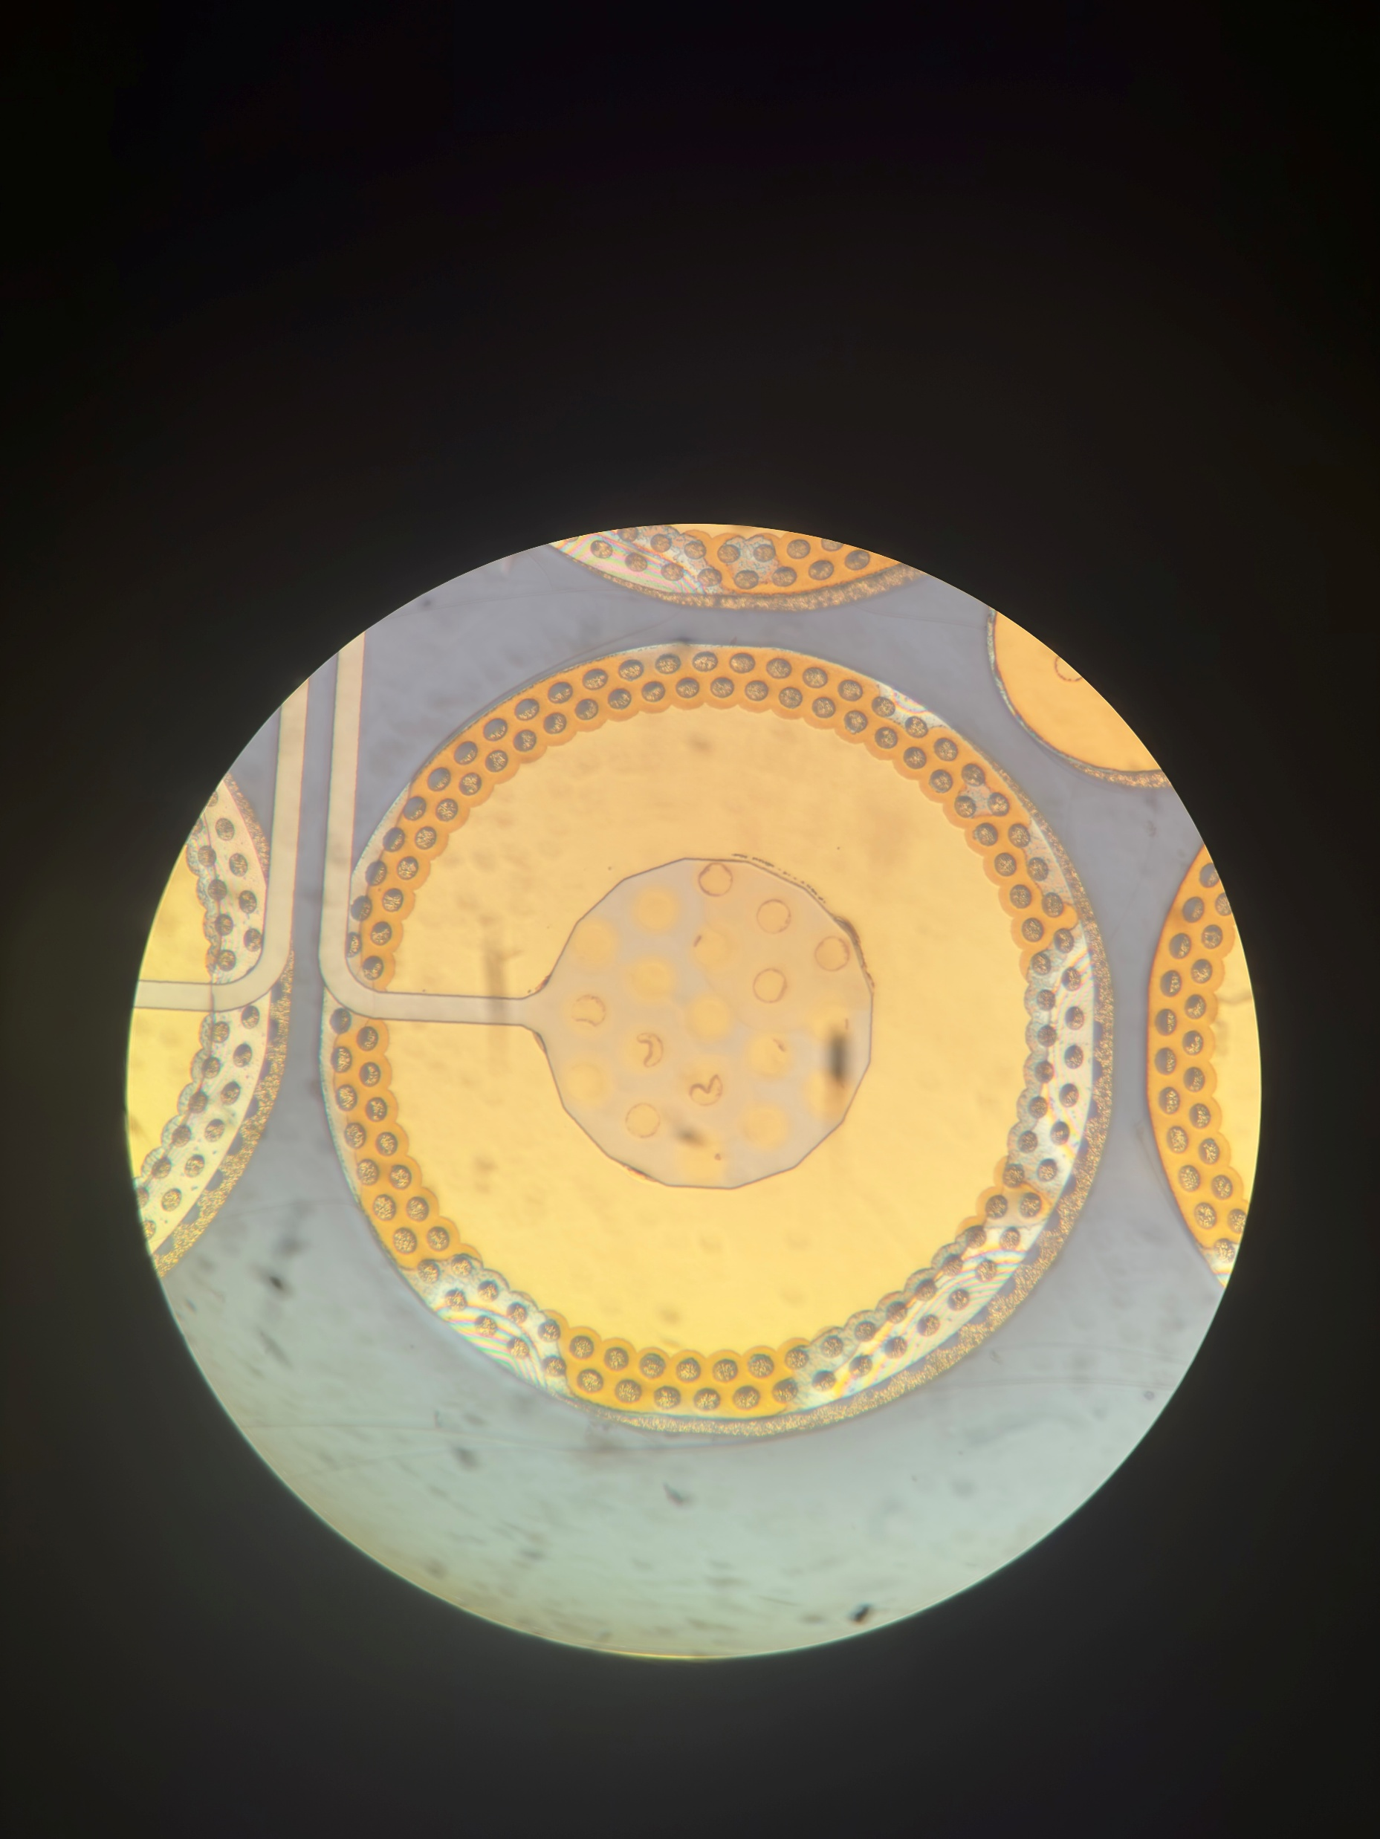
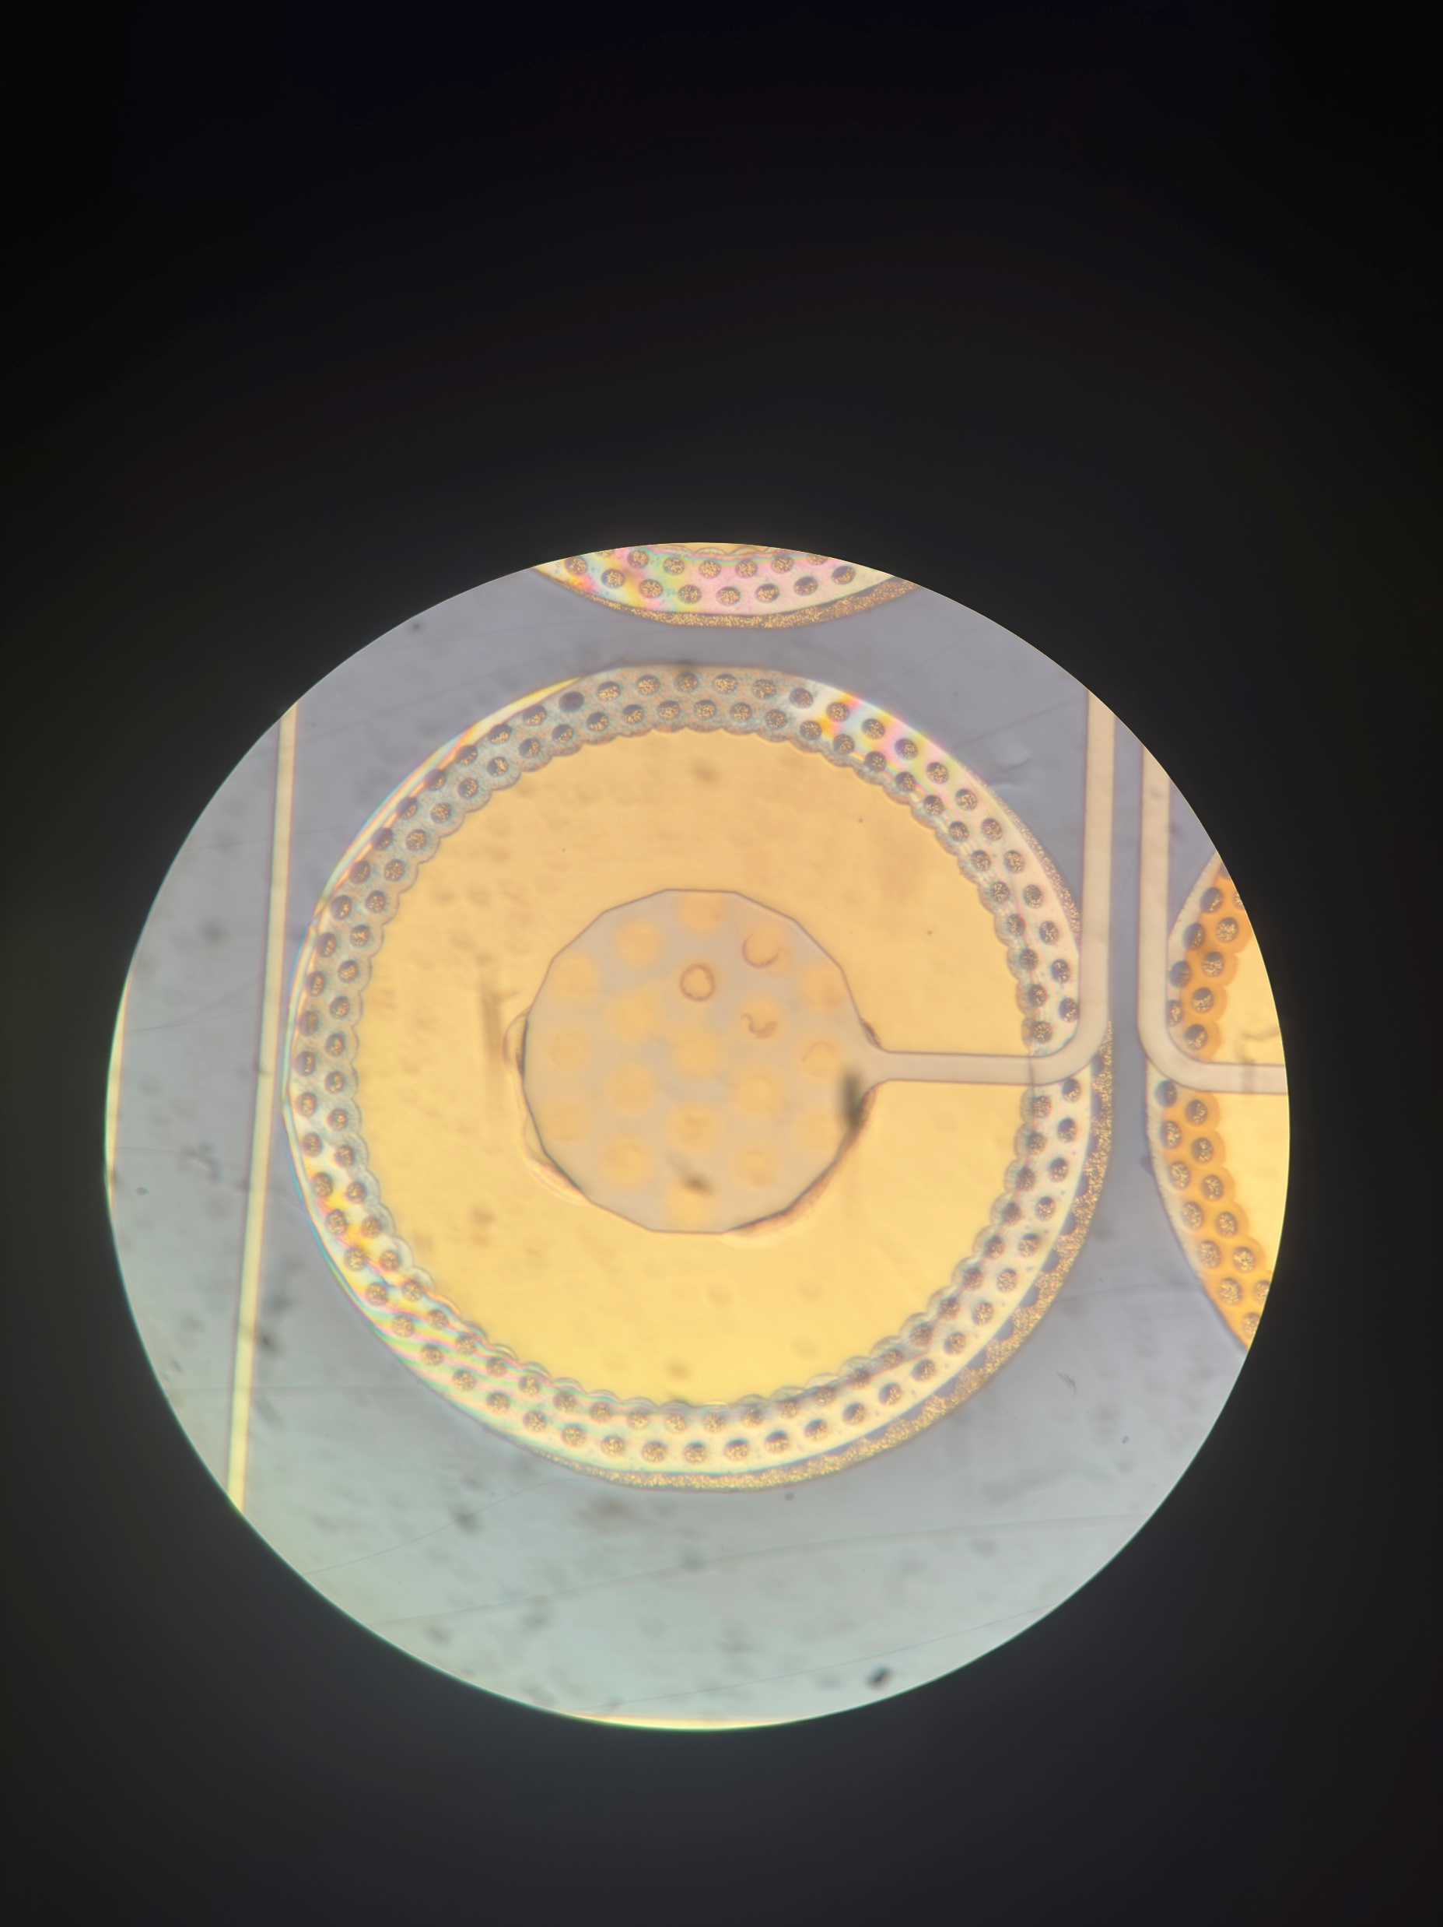
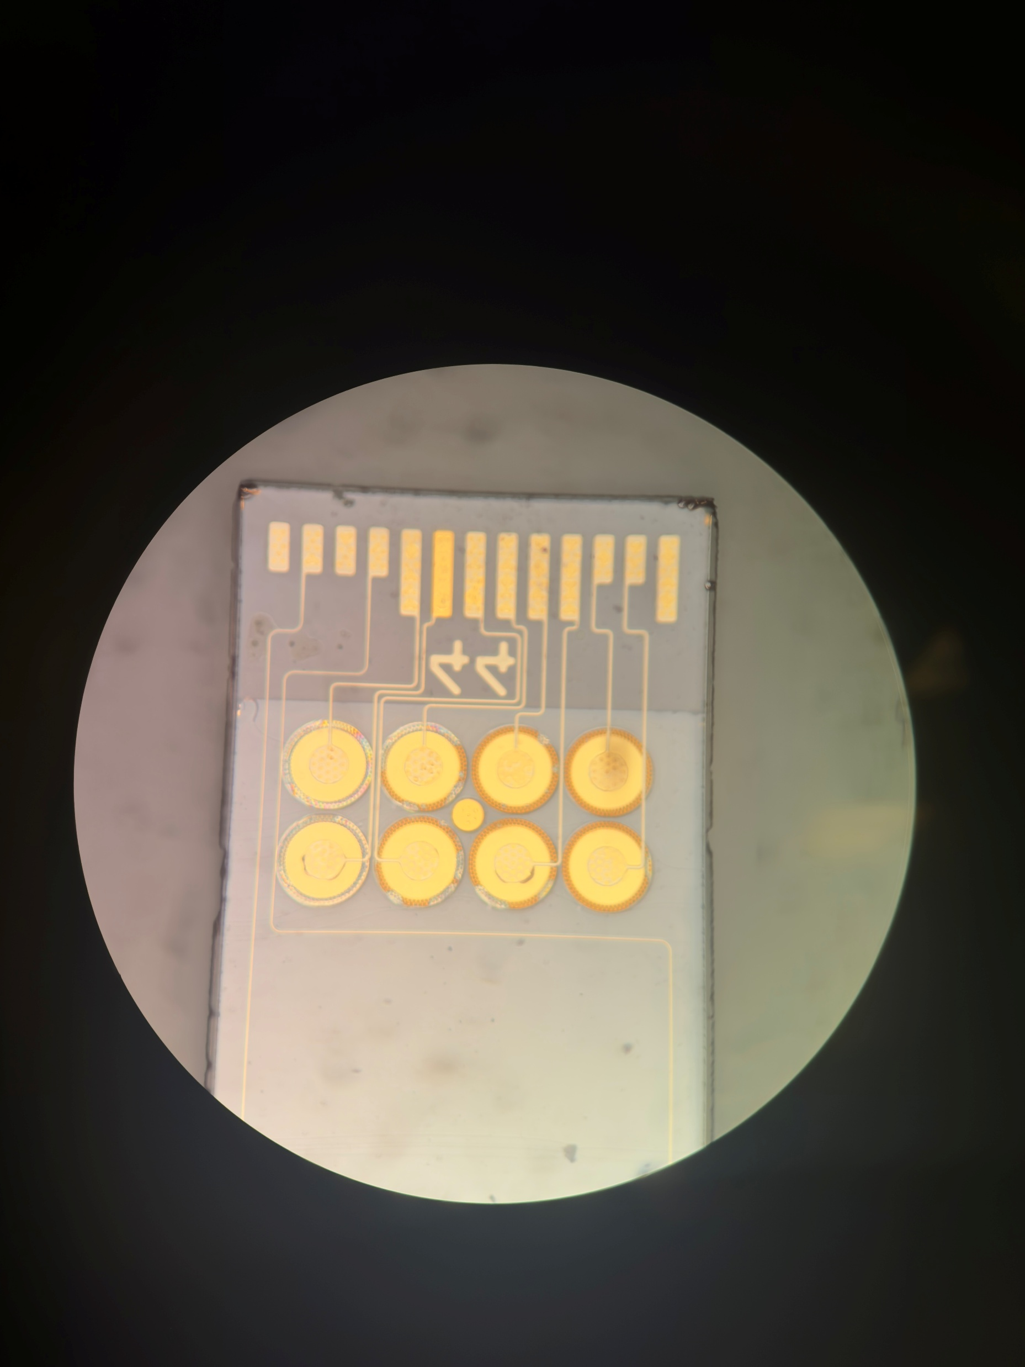
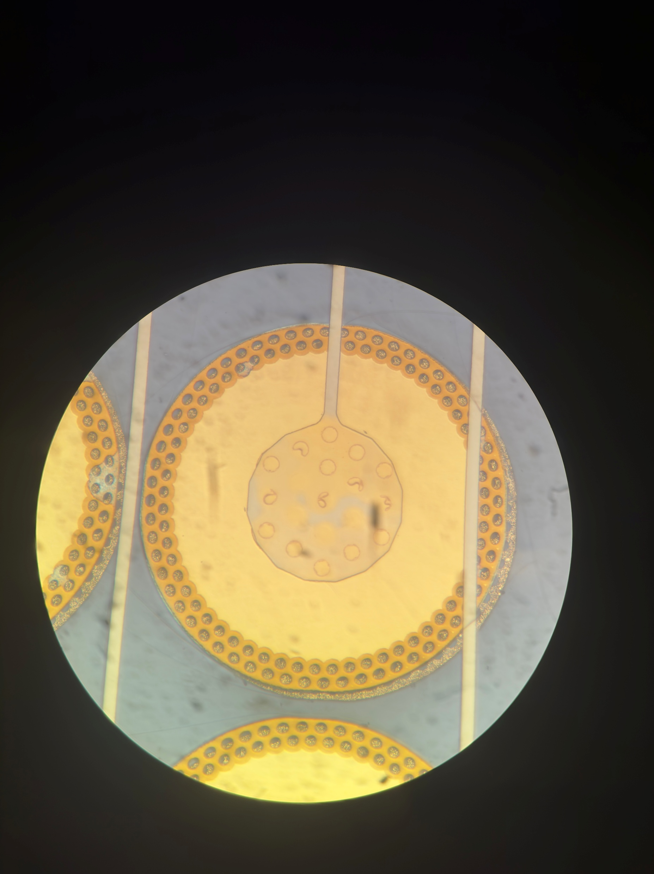
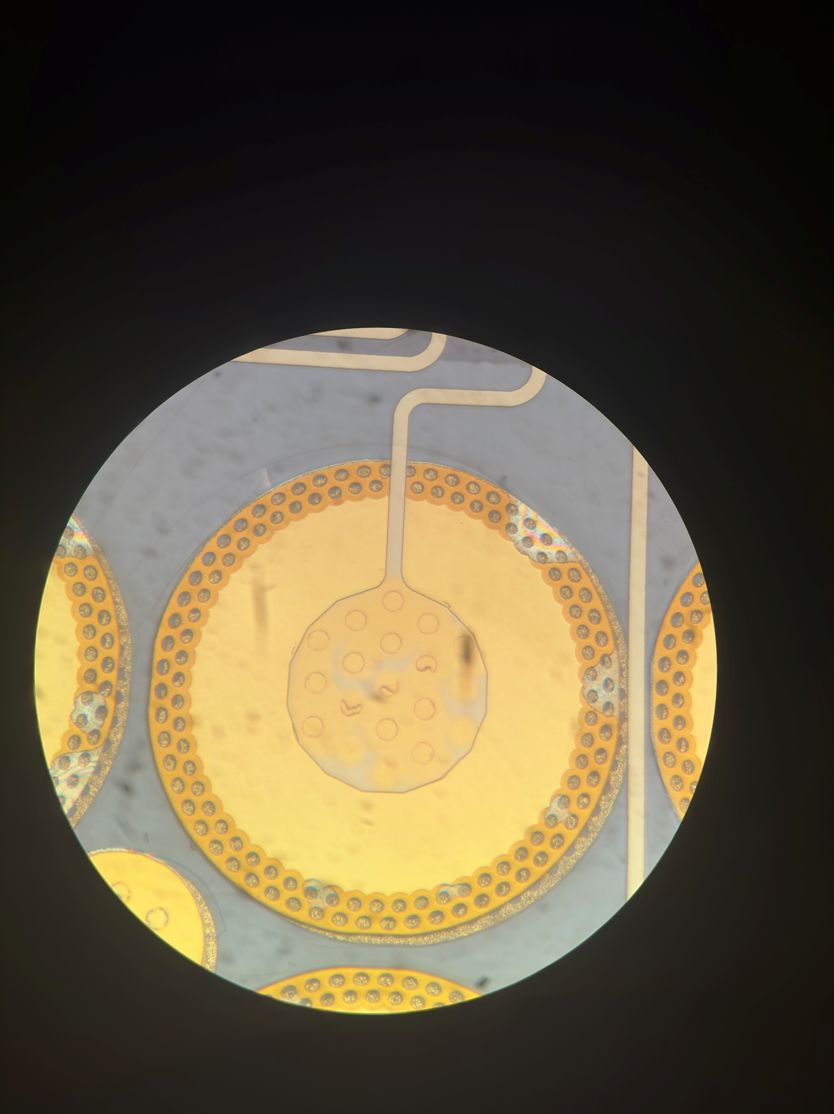
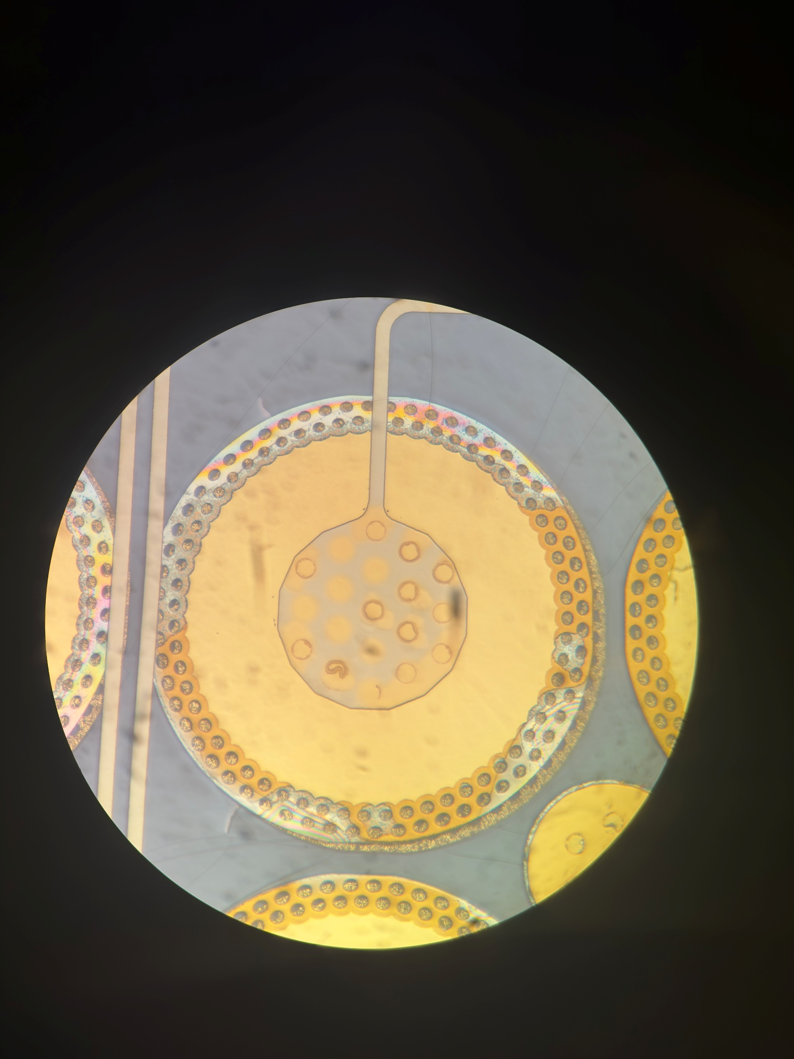
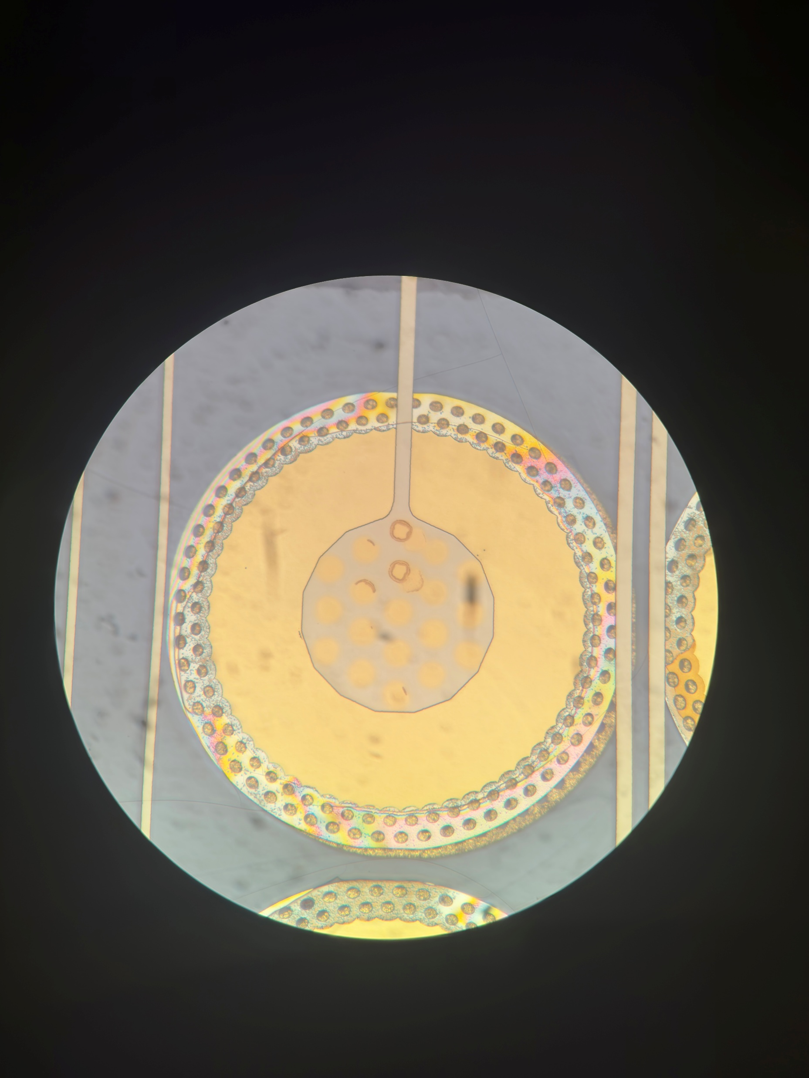
44 Backside Nearside
Post Anneal
Notes:
Webbing helps to protect the inner material by distributing the pressure more evenly

Slide 11
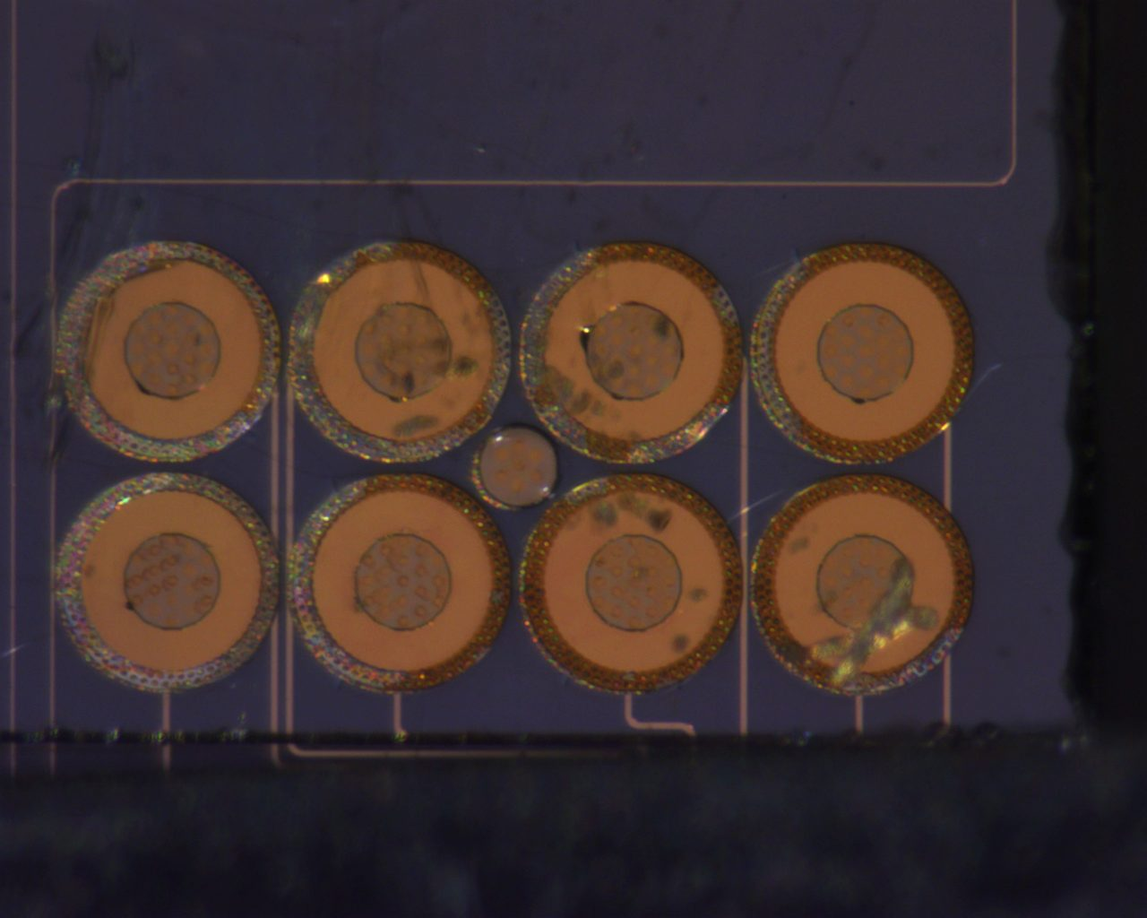
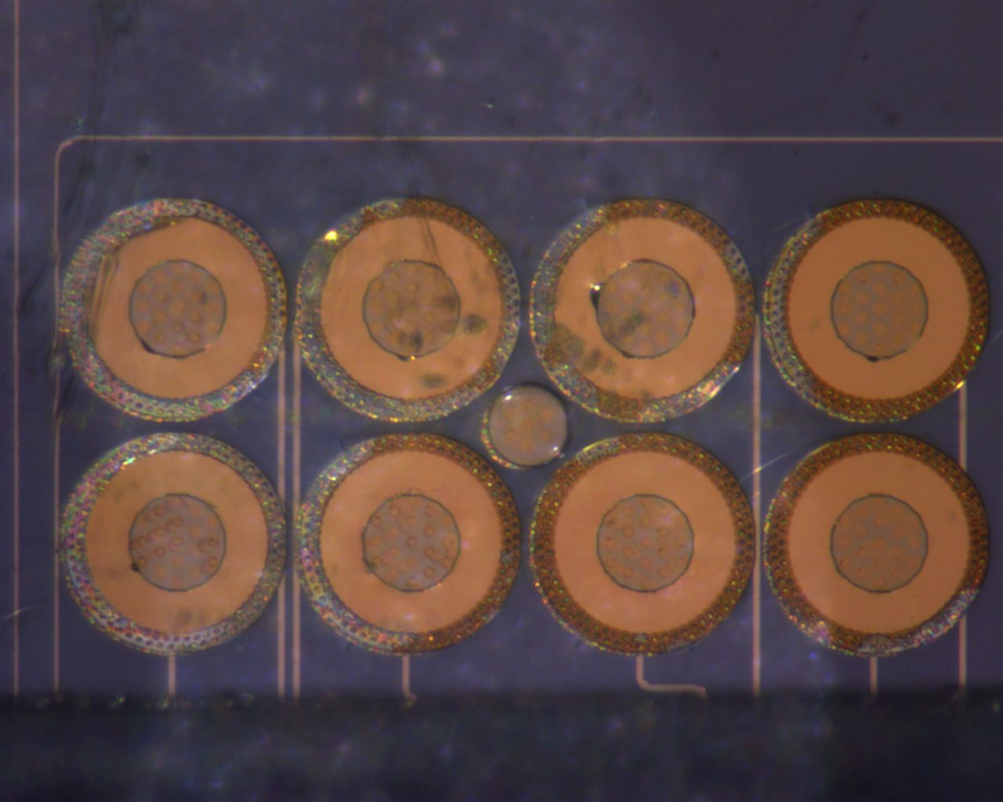
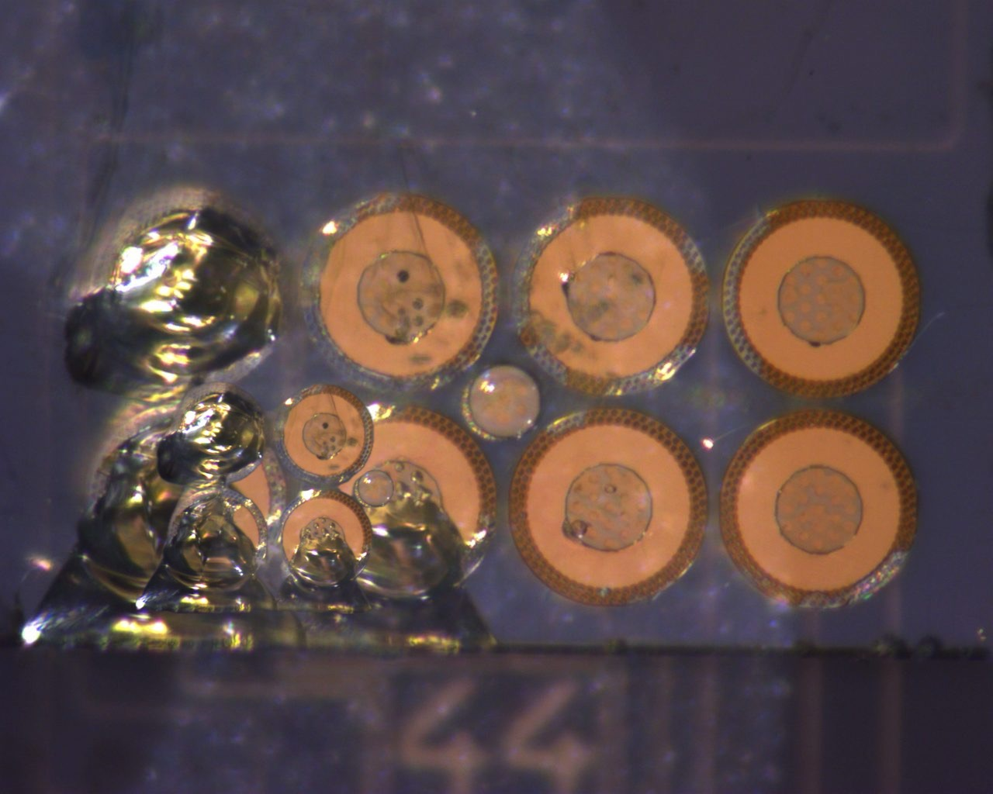
53 Backside
Pull Test Post Anneal Progression 1-3N

Slide 12
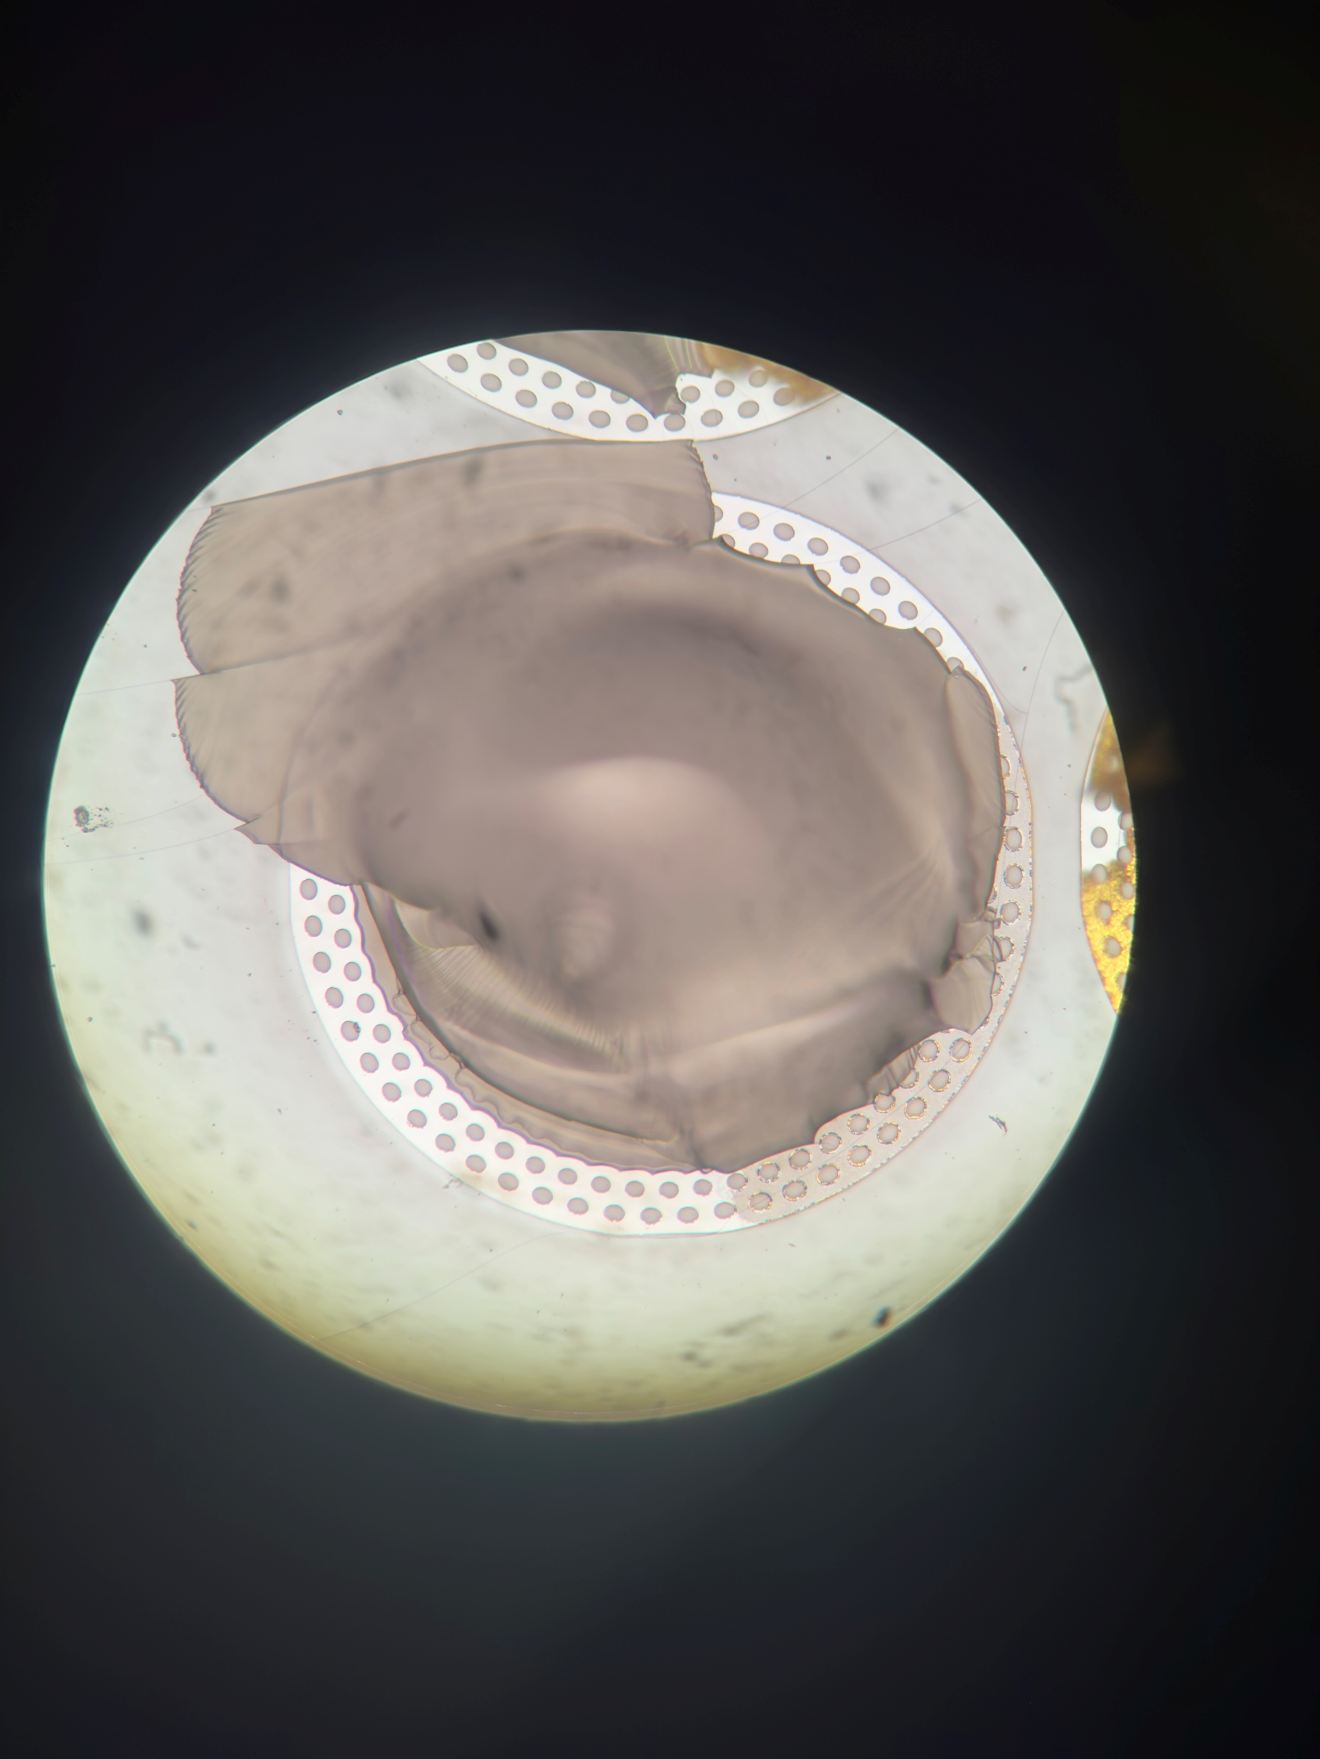
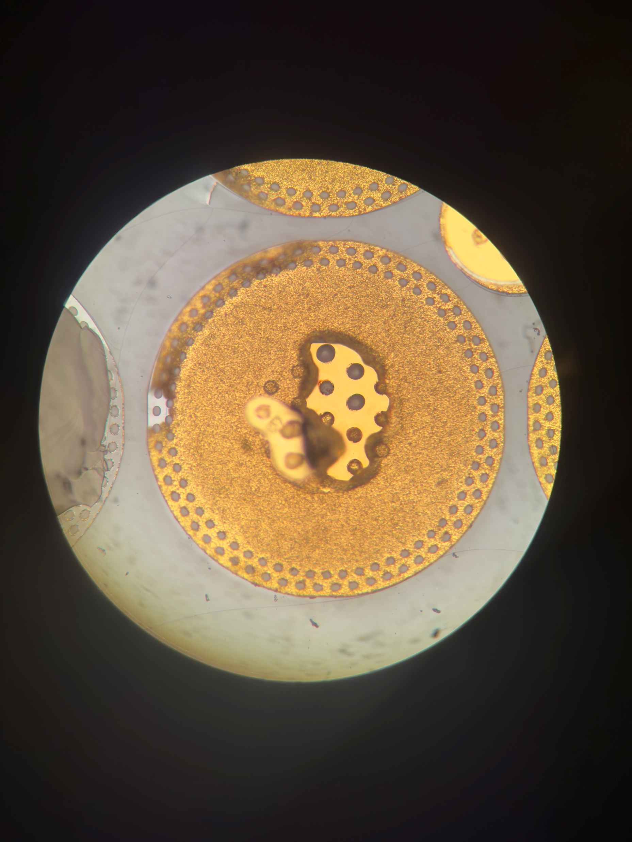
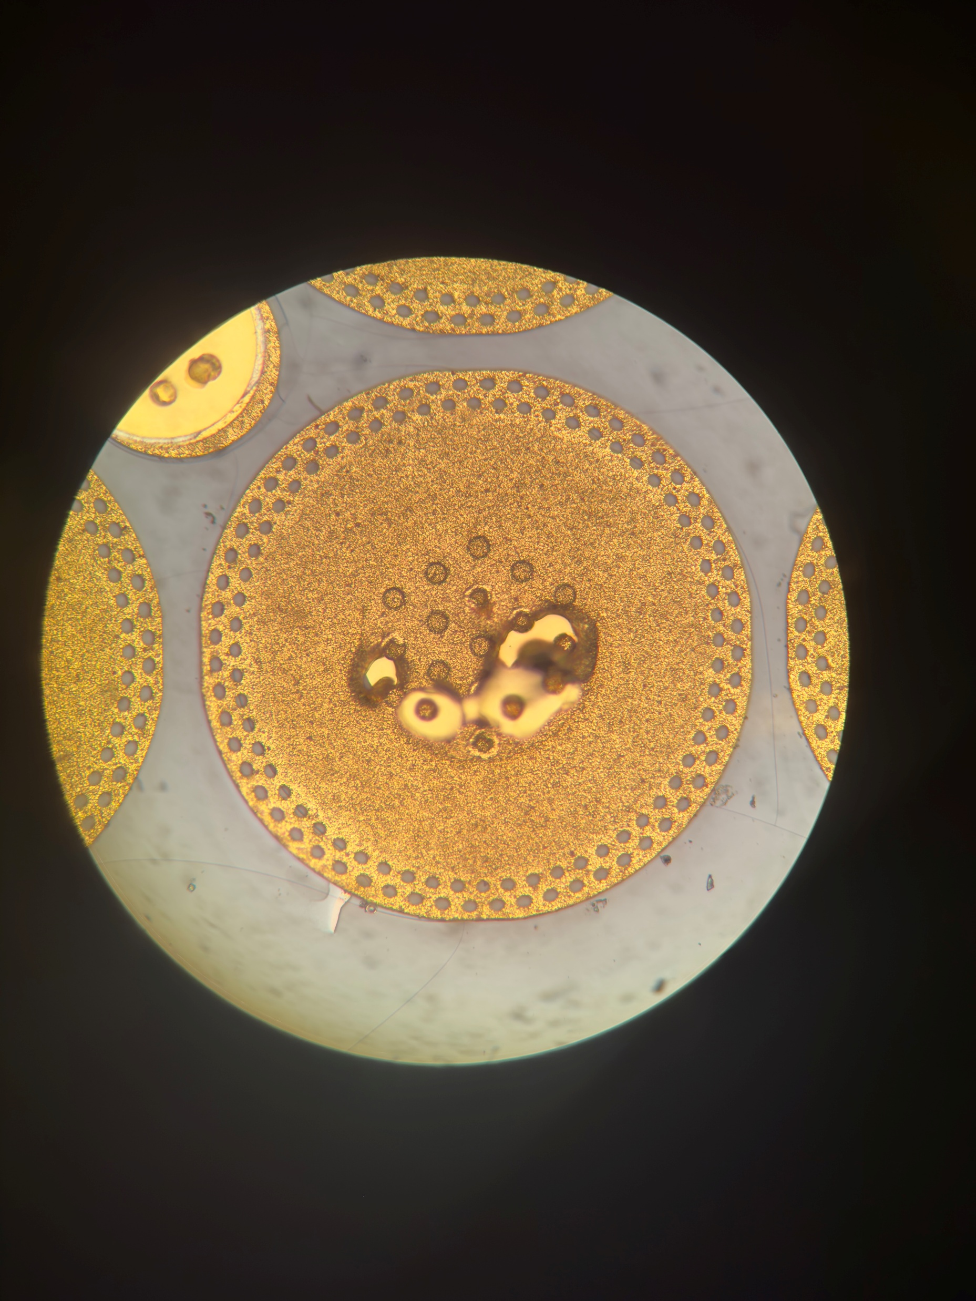
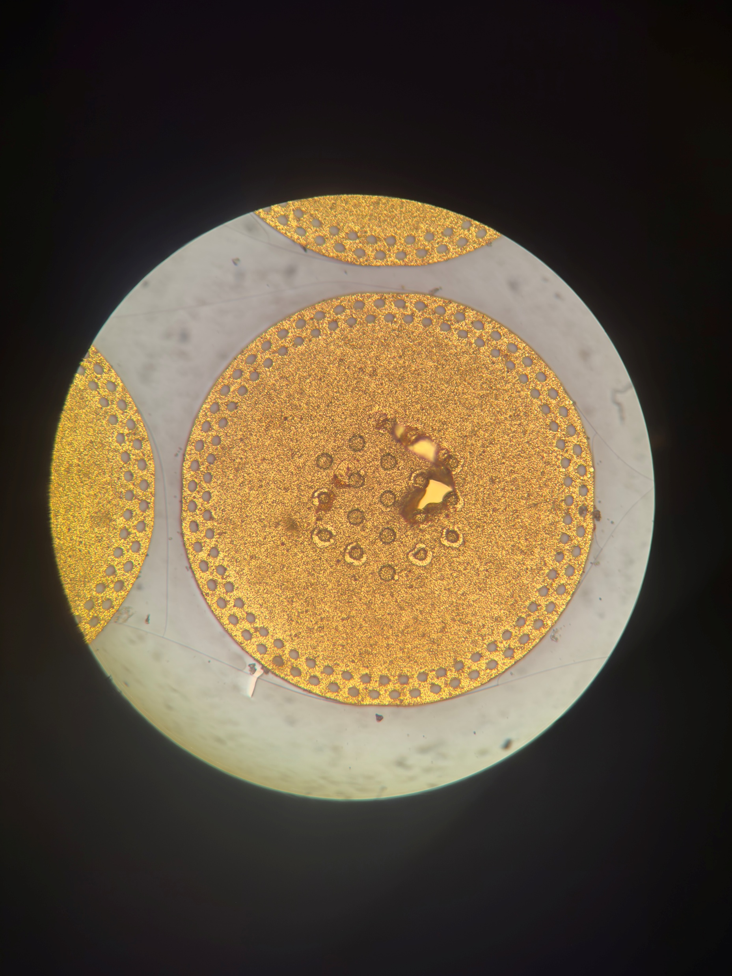
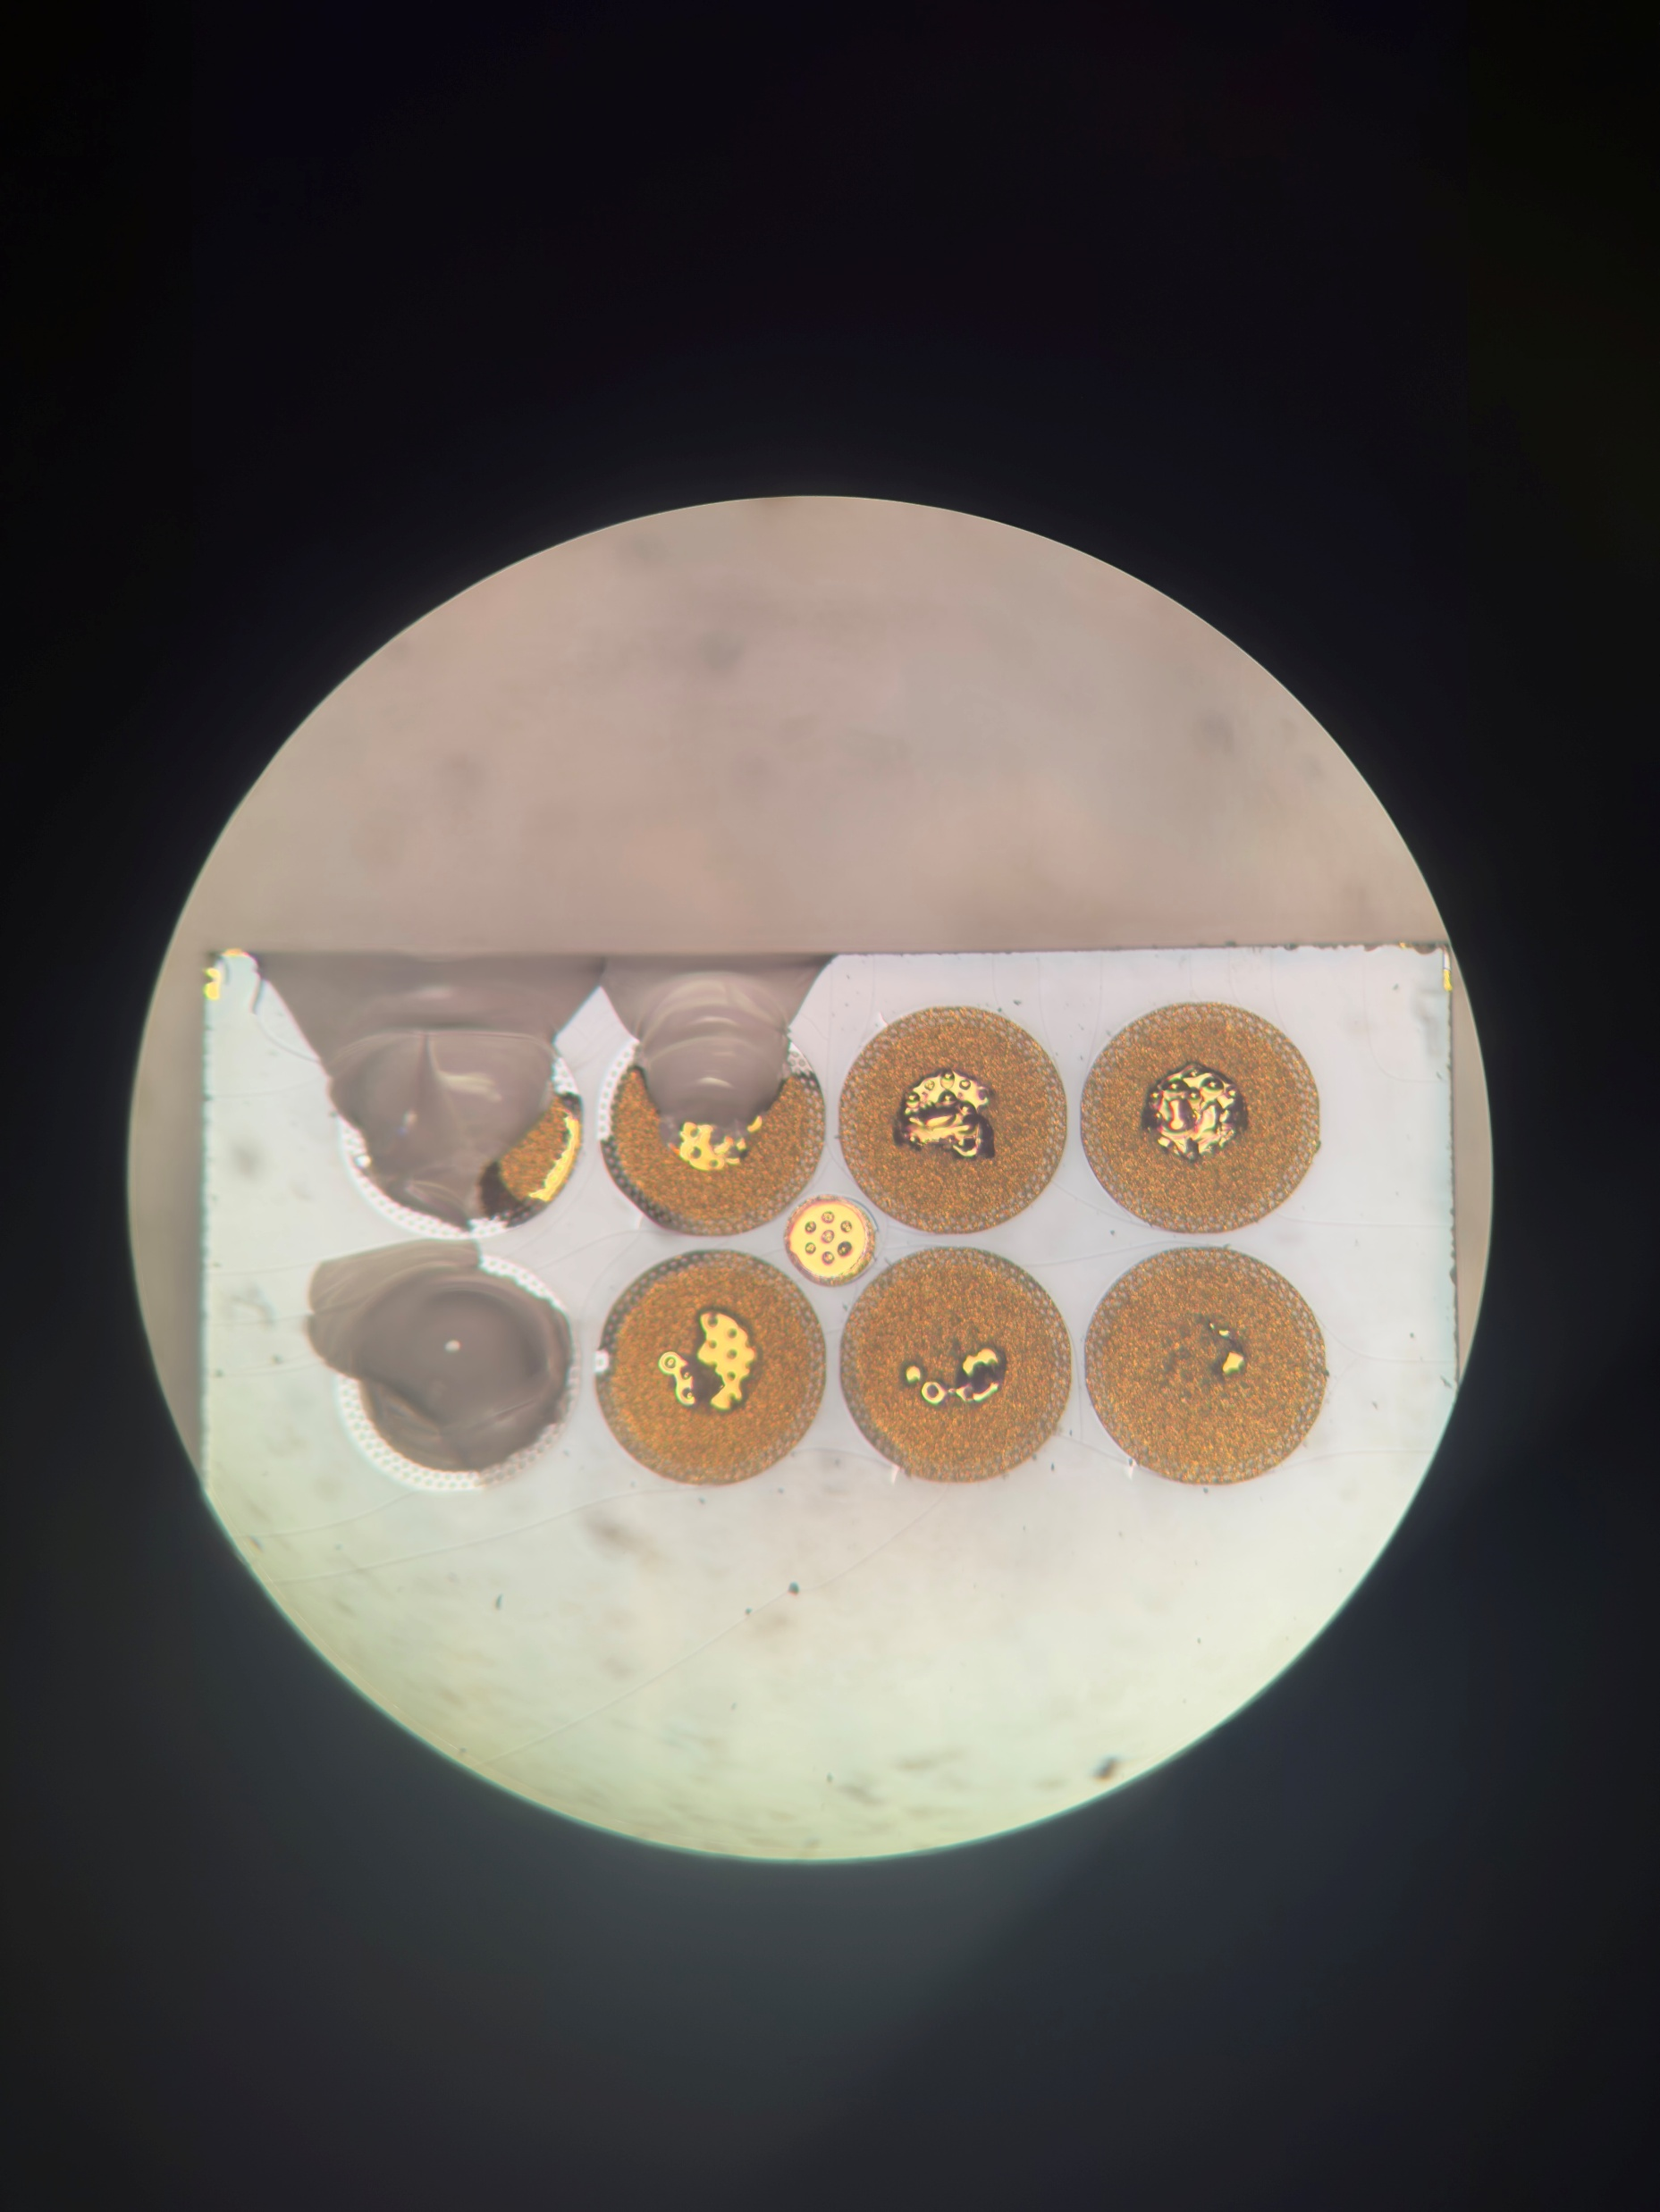
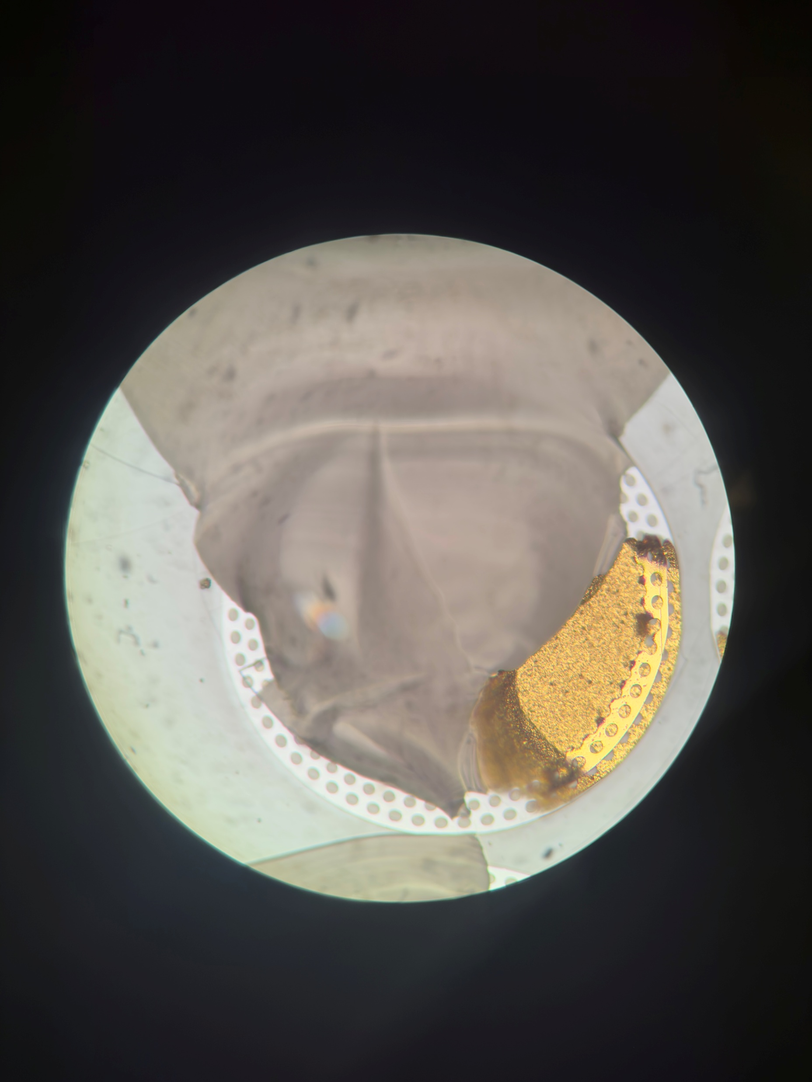
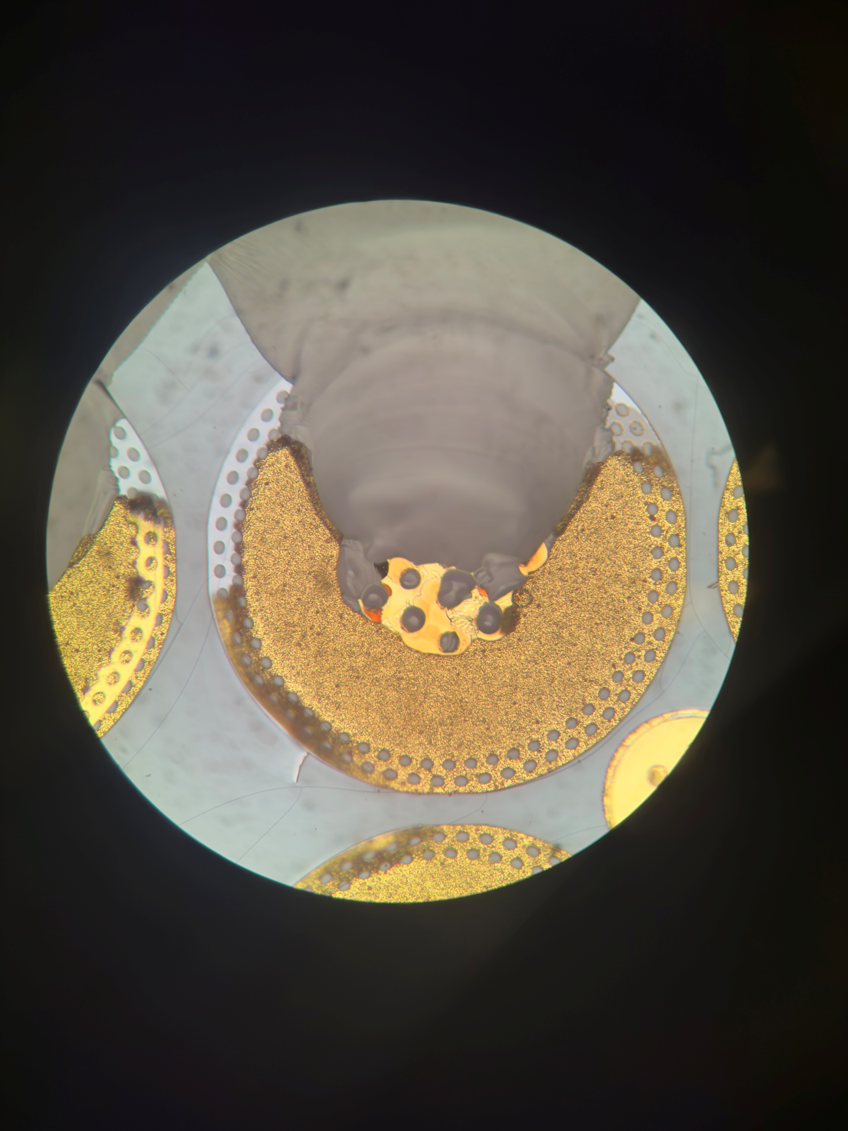
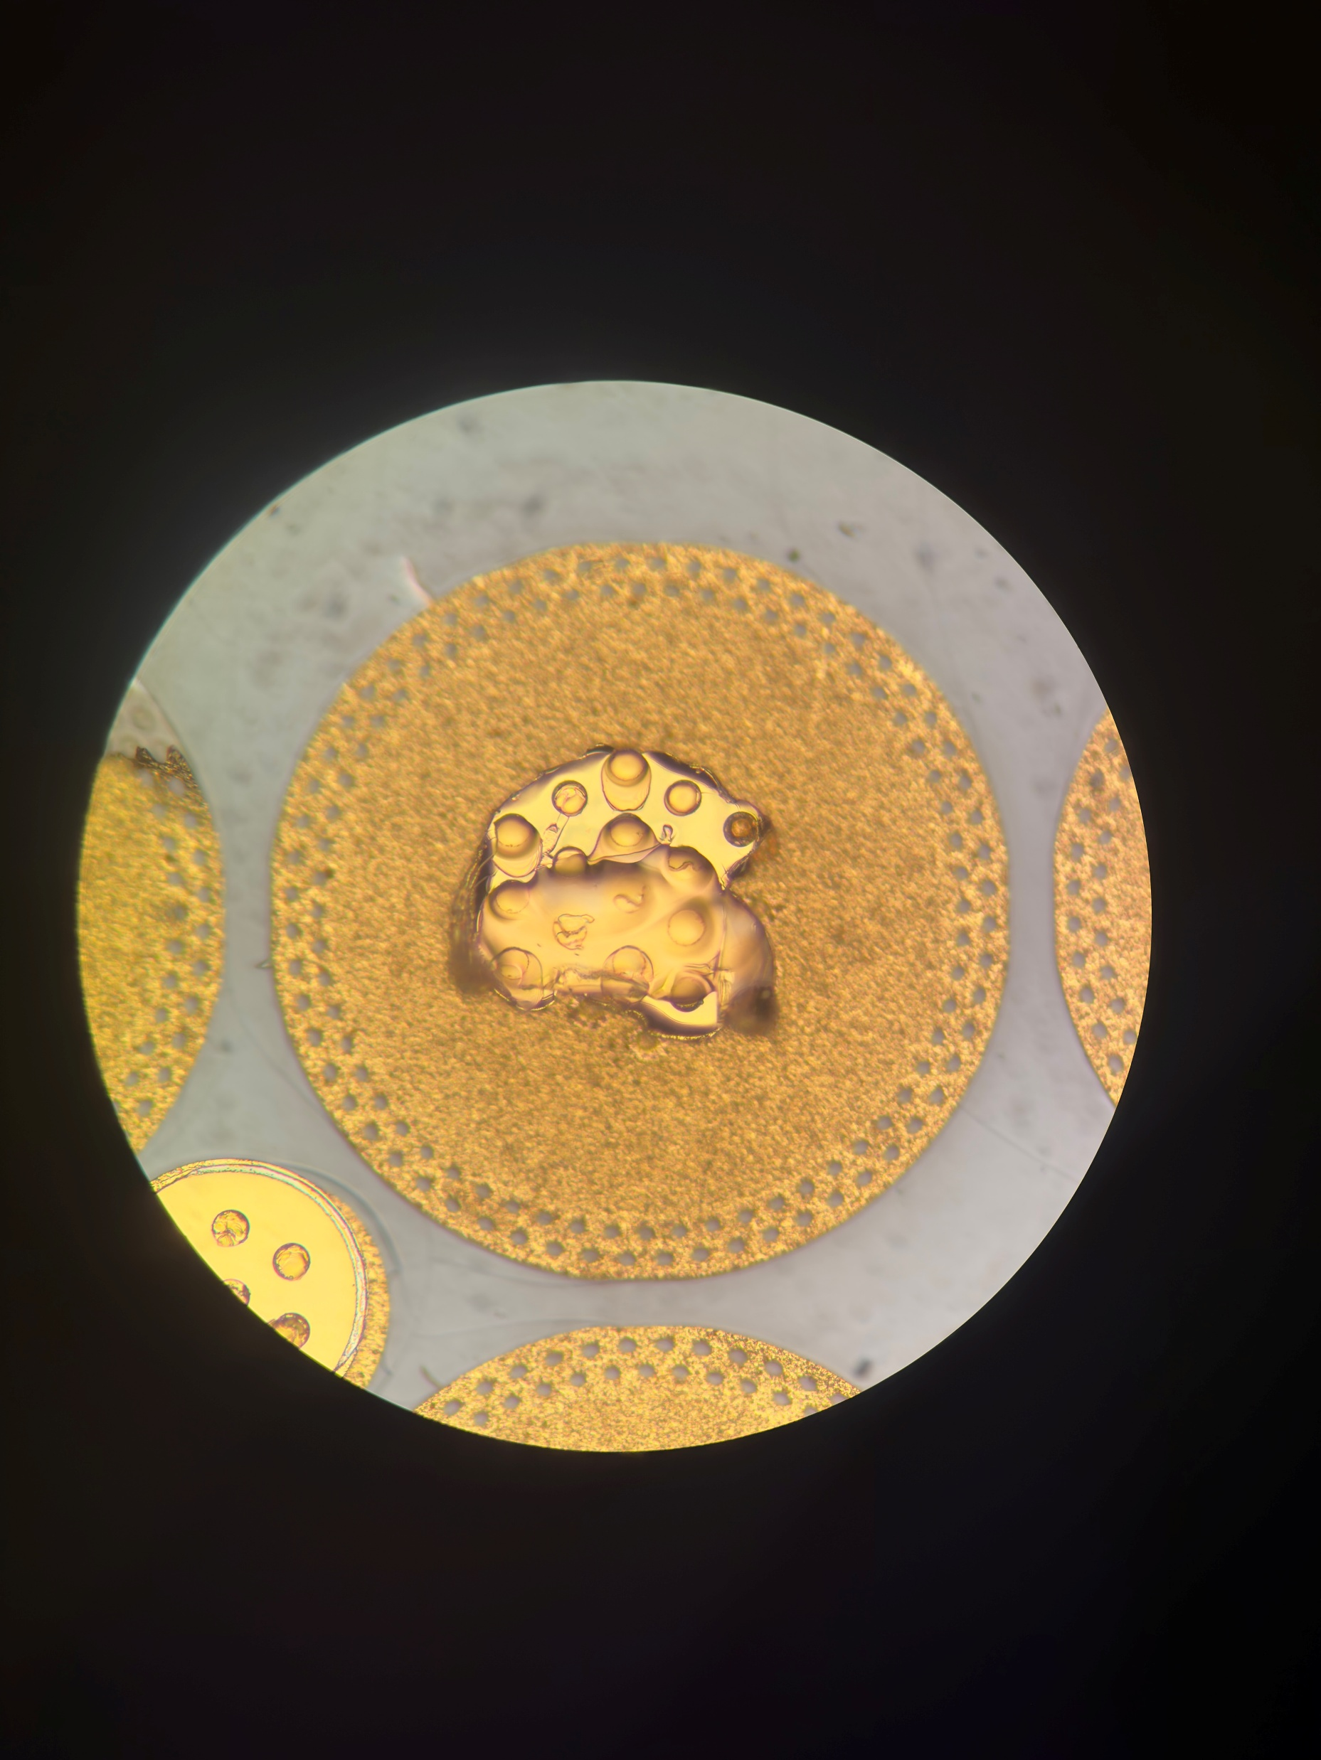
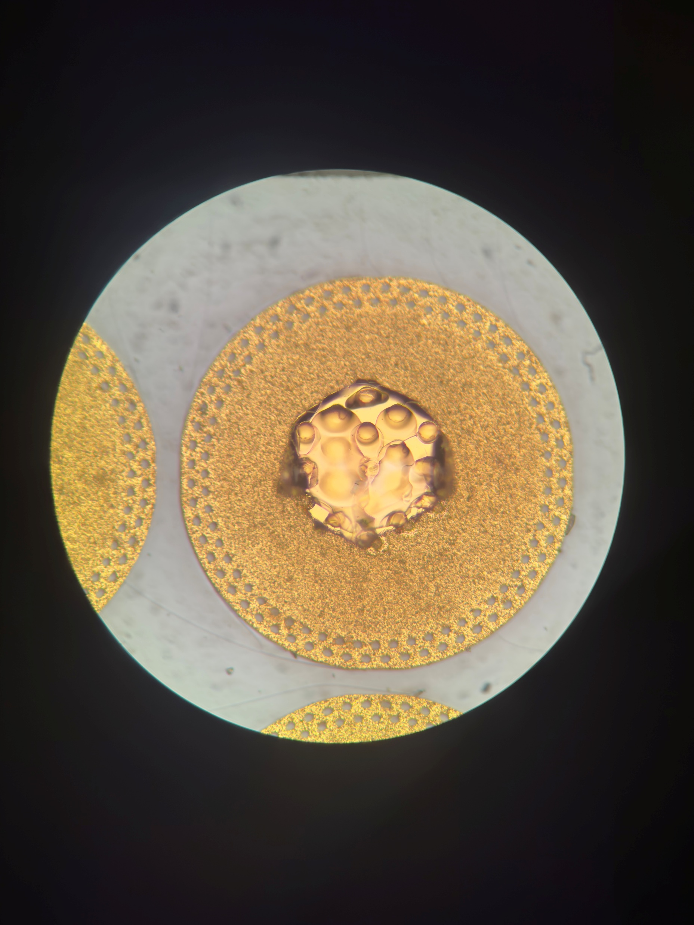
53 Farside

Slide 13
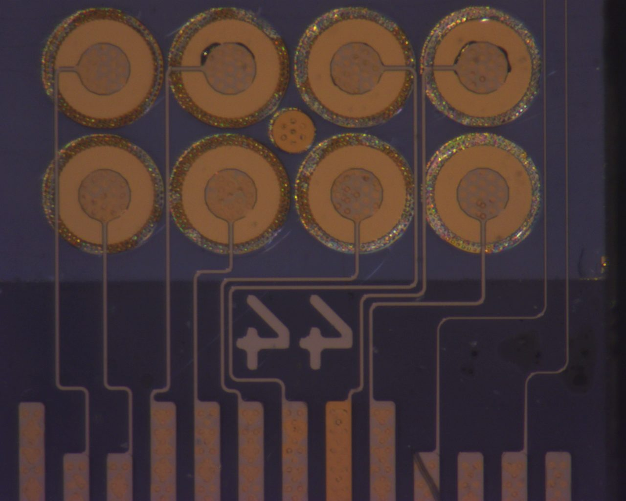


44 Backside
Pull Test Post Anneal Progression 1-3N

Slide 14









44 Nearside

Slide 15


53 Farside Pad 2

Slide 16


A
B
B
A

Slide 18

53 Farside Pad 6

Slide 19

A
B
B
A

Slide 20


Slide 21
44 Nearside Pad 6

Slide 22
44 Nearside Pad 3

Slide 23
53
44

Slide 24
Summary (Pull Test Failure)
Minimal formation of conchoidal fractures during bonding process
Any large glass fractures (44Farside Pad 1-3) occurs from pull test
Strongest bonds formed here
Iridescence still seen after bonding
Is not necessarily a point of failure
Only 1/32 pads has delamination occurred, but was point of failure for that bond.
Pressure is applied quite evenly, but still results in uneven bonding – on both sides, the large glass fractures are along 1 edge
Flip the strips after bonding each side, and halve the time.

Slide 25
Summary (Anneal)
Anneal causes compound between titanium and gold to form
Responsible for change in colour
But on the metal 1, is responsible for rings to form around the bases of vias
In most cases, this is a point of failure into glass, may be pre-stressing the glass there and forming fractures

